Slide 2
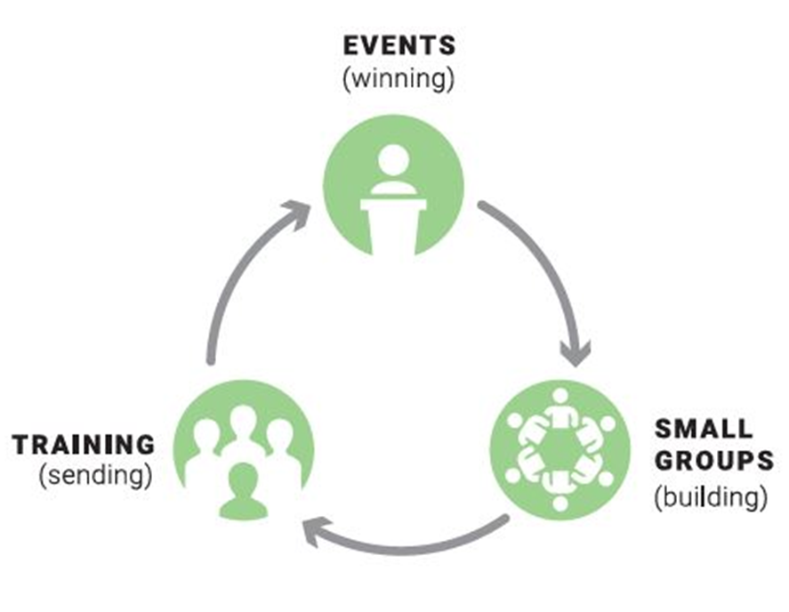
INTRODUCTION
FamilyLife® Core Strategy
Events (Winning)
Small Groups (Building)
Training (Sending)

Slide 3
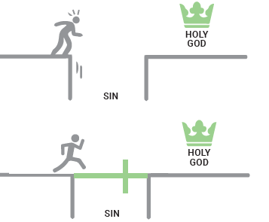
OUTREACH AND EVANGELISM
As important as a good marriage is, it isn’t as important as having a relationship with Jesus Christ.
Nevertheless, the felt need of family is a wonderful way to minister to couples, opening the door for the most meaningful and effective gospel presentations.

Slide 4

WHAT IS THE GOSPEL WE SEEK TO SHARE?
There are many methods of sharing about Jesus, his death and resurrection, and salvation through faith in Christ. A succinct summary of the essentials a person needs to know to receive forgiveness of sin can be found in The Four Spiritual Laws. An online adaptation called “Would You Like to Know God Personally?” is available at cru.org.
There are many other good things a Christian can or should do. But we believe these are the essentials for a saving relationship with God. Because a person’s relationship with God is the most important aspect of life, we believe in trying to remove any non-essential obstacles to a person receiving Christ as Savior and Lord.

Slide 5



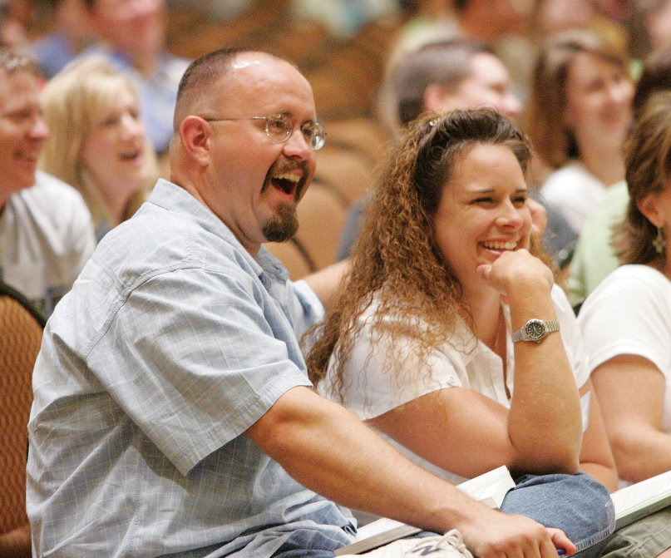
EXAMPLES OF METHODS OF EVANGELISM
Exposure events (a few hours long)
Couples Relationship Seminar (1 or 1½ days)
Christmas gatherings/cookie exchange (19 in one year)
Sharing The Four Spiritual Laws in FamilyLife small groups
Secular media advertising – WTR and exposure events
Individual appointments

Slide 6

SPEAKING AT EVENTS
(including emceeing AOM and conducting engaging training)
“Never stop improving your communication.”
(Dr. Bill Bright)

Slide 7
Strengths of Your Partnership

Slide 8
THE IMPORTANCE OF QUALITY SPEAKERS

Slide 9
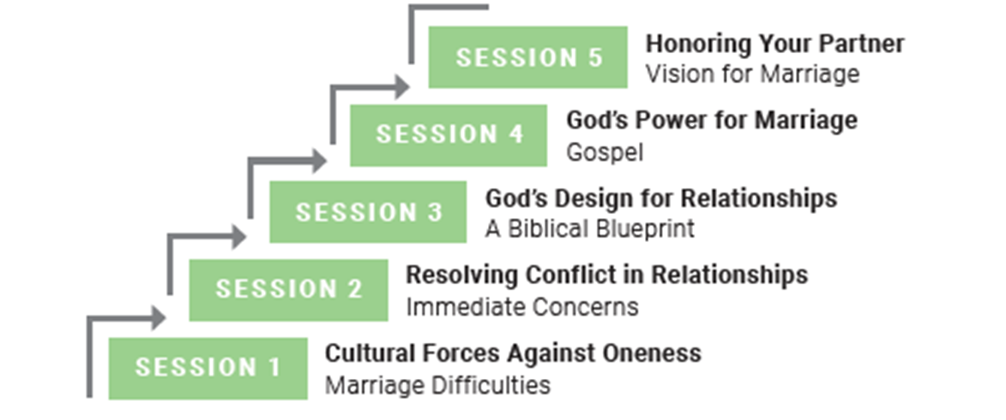

CONTENT
Global Event Resources:
Weekend to Remember
Couples Relationship Seminar
Art of Marriage
FamilyLife Couples Studies

Slide 10
AUDIENCE CONNECTION
FamilyLife speakers must establish credibility and a level of trust between themselves and the audience as quickly as possible.
Before the event
As you begin
Understanding the audience

Slide 11
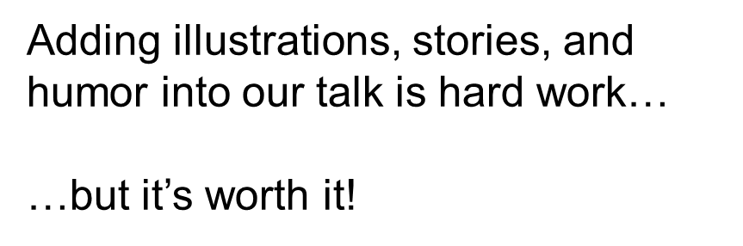
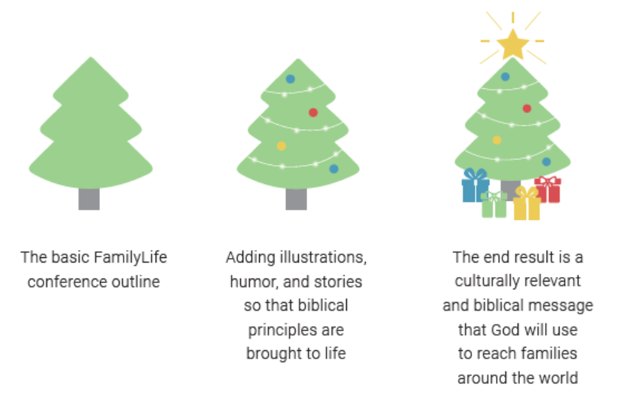
ILLUSTRATIONS
Types of illustrations
Reasons for storytelling
Effective storytelling

Slide 12
Start preparing to deliver your three-minute testimony to the other participants.

Slide 13
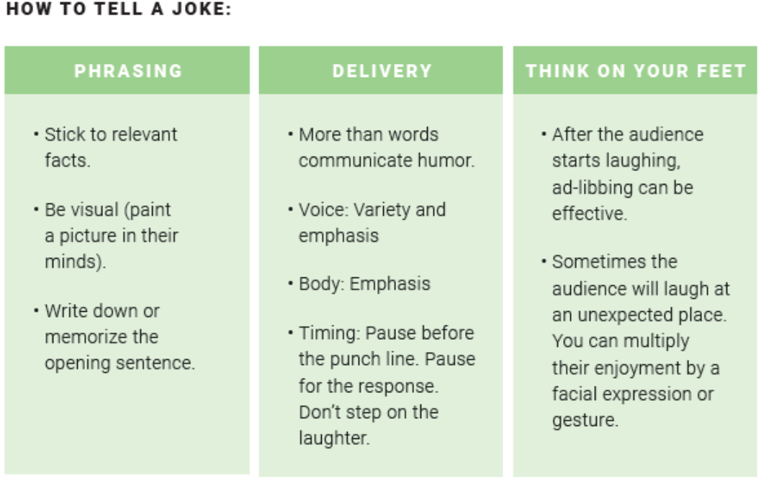
HUMOR
Including humor
Types of humor
Mistakes to avoid

Slide 14

TIMING
Make travel arrangements with a margin for error
Begin and end talks on time
Stay on schedule

Slide 15
End of First Day

Slide 16

Deliver your three-minute testimony to the other participants.

Slide 17
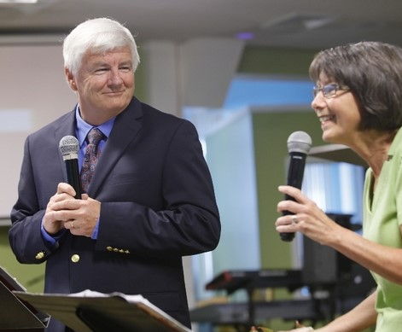
HUSBAND/WIFE TEAM
Speaking together as a couple
Preparation
Delivery Tips

Slide 18

Select a session from an outline of a FamilyLife event. Start preparing a 20-minute portion of that session to deliver as a couple to the other participants.

Slide 19

EYE CONTACT/FACIAL EXPRESSIONS

Slide 20
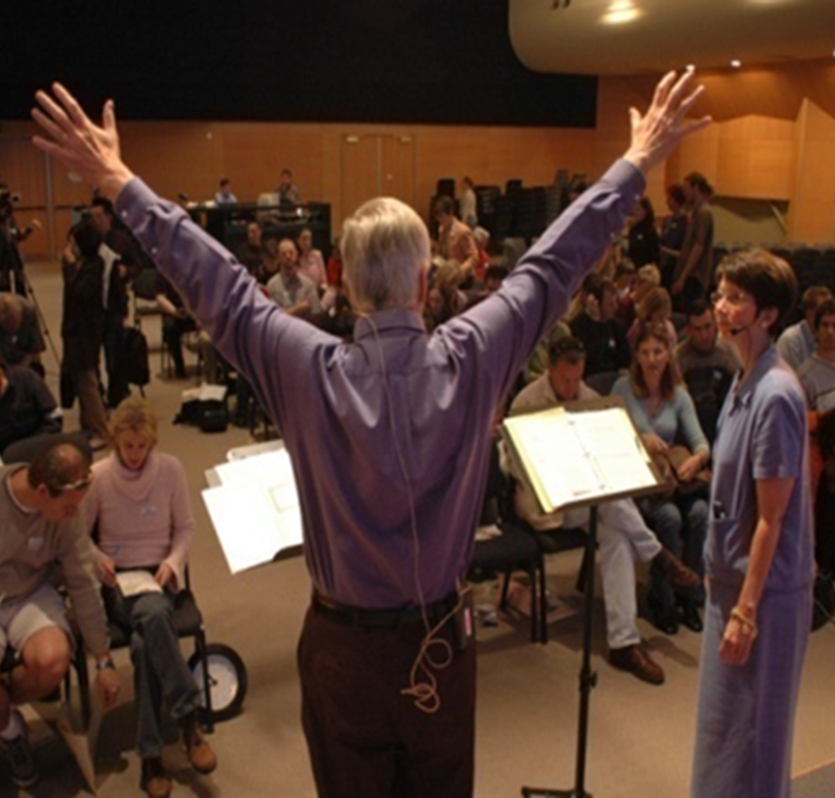
BODY LANGUAGE / GESTURES
Determine them
Practice them
Review them
Present them
When not gesturing

Slide 21

VOICE
Microphone
Pace
Tone
Pauses

Slide 22
NOTES AND VISUAL AIDS

Slide 23
End of Second Day

Slide 24
Deliver a 20-minute portion of that session as a couple to the other participants.

Slide 25

DRESS / APPEARANCE

Slide 26


TEAMWORK
HomeBuilders® / AOM Connect Series / Couples Studies
More than 2.5 million distributed
20 different topics
47 languages

Slide 27

PROMOTING EVENTS
Offering events is pointless unless people attend.
Promotion is an essential aspect of a FamilyLife ministry.
FamilyLife Global offers an excellent guide to attracting audiences to any event.

Slide 28






GLOBAL’S TRAINING RESOURCES

Slide 29
End of Third Day

