Slide 1
FAMILYLIFE
Global Outreach
Strategies and Resources
Notes:
PRESENTER NOTES: Your training presentation of this material will be far more effective if you will add illustrative stories like a Weekend to Remember speaker does. Jesus told story after story. Stories touch people’s hearts and are memorable. (i.e. Who can forget the parable of the Good Samaritan?) The best stories are personal – even with the mistakes that are made, and the lessons learned. But stories can also be taken directly from the Bible or the experience of another couple. Stories need to be short and rehearsed beforehand. Jesus’ Good Samaritan parable is 179 words. Jesus never told a story longer than 500 words. More words are likely to bore your audience.

Slide 2
Biblical Importance of Families
Families are God’s plan to raise children.
Almost every social problem, whether it be crime, violence, drug abuse, abortion, ruined lives, hopelessness, or greed, is contributed to by ineffectual families.
Many people today both inside and outside the church desperately desire help for their marriages and families but don’t know where to look. Fortunately, the Bible gives clear directions for having a successful family.
The felt need of family relationships has also brought many thousands to the knowledge of Jesus Christ.

Slide 3

Basic Requirements to Start a Ministry

Slide 4
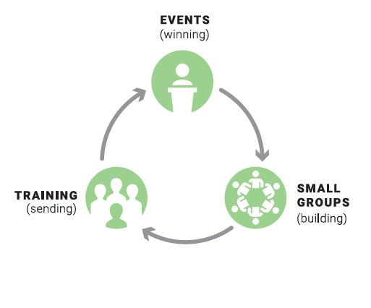
FamilyLife Local Ministry Strategy based on Jesus’ example
Events (Winning)
Date-night events
Low-commitment weekend events
Large events like Weekend to Remember
Small Groups (Building)
Marriage groups
Parenting groups
Women’s or men’s groups
Training (Sending)
Evangelism
Discipleship
Small-group facilitator
Speaker training
Although winning, building, or sending can occur in any of the activities, the diagram shows the most common.
Notes:
PRESENTER NOTES: Take some time to explain this circle.
SCRIPT: “This circle is an ongoing process involving all three of FamilyLife’s key ministry elements. Events. Small Groups. Training. Together the elements support each other and give volunteers confidence that FamilyLife has a proven plan that has been effective over the years.
As a movement develops the cycle can revolve faster and faster as well as grow bigger and bigger. AND the beauty of the cycle is that people can enter the cycle at any element and can move in either direction.

Slide 5
Ministry Versus Movement
A Movement is of God. You can’t build one.
You can build a ministry that God can turn into a movement.

Slide 6
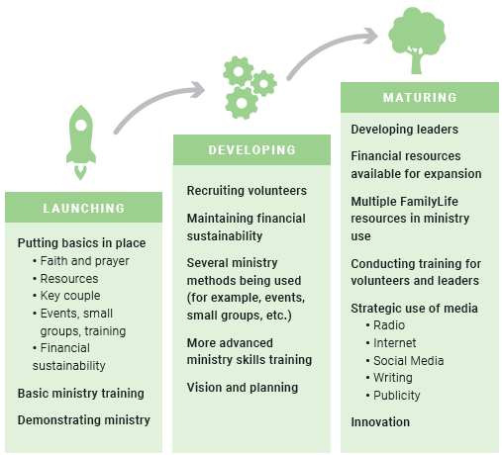
Stages of Ministry Development

Slide 7
Role of Events Win people to Christ and catalyze people to the movement
Events (Winning)
Date-night events
Low-commitment weekend events
Large events like Weekend to Remember
Small Groups (Building)
Marriage groups
Parenting groups
Women’s or men’s groups
Training (Sending)
Evangelism
Discipleship
Small-group facilitator
Speaker training

Slide 8
Events
Jesus frequently taught in front of gatherings of people.
Several categories of events can be part of a developing FamilyLife ministry, including Major Events, Exposure Events, and Training Events.
Events might be organized in one of two different ways: organized by FamilyLife or organized by others.

Slide 9
Types of Events
Major Events: A full day or more of teaching biblical principles for families. Couples’ activities and project time are included in the experience.
Low-Commitment Events: Generally one or two marriage talks and a few activities to expose a group to FamilyLife. If done well, many of the audience will attend subsequent major events or participate in small groups.
Training Events: Can be from an hour to a full weekend. Training events teach FamilyLife strategies and equip couples to use resources as FamilyLife Local. Participants enjoy training more if a few advanced marriage principles are mixed in with the how-to instructions.

Slide 10
Role of Small Groups Discipline others in the ways of Jesus and identify leaders
Events (Winning)
Date-night events
Low-commitment weekend events
Large events like Weekend to Remember
Small Groups (Building)
Marriage groups
Parenting groups
Women’s or men’s groups
Training (Sending)
Evangelism
Discipleship
Small-group facilitator
Speaker training

Slide 11
Permanent Life Change
“You make an impression on people from a distance. You make an impact on people when you get up close.” (Dr. Howard Hendricks)
Putting everything from a major event into practice can be like trying to swallow an elephant. But small-group studies are like cutting the elephant up into bite-sized pieces.
“The WTR creates a desire to change. Small groups make that desire a reality.” (Jerry Wunder)

Slide 12
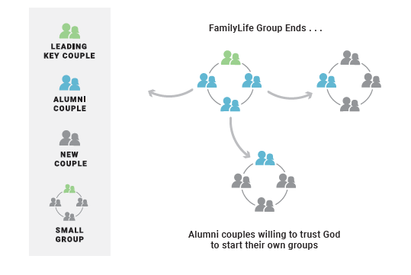
Effective Small-Group Multiplication
Groups ending may be part of God’s plan
Stay in touch with leaders
Be patient
Notes:
SCRIPT:
“The end of a small group may even be part of God’s plan. Jesus said, “Unless a grain of wheat falls into the earth and dies, it remains by itself alone, but if it dies, it bears much fruit” (John 12:24).
Most small groups end before they multiply. The reason is that couples normally come to a group with needs. Once that need is met, they may lose interest. Later when new needs surface they may start their own group; even years afterward. And that’s okay. We never encourage groups to end. But when they do, we look forward to seeing who may emerge as future leaders from that group. (Small Group Manual p 48).
Active multiplication of small groups looks like bubbling oatmeal. (SGM p 50)” READ the story
Organic ministry growth may look VERY different from what you might expect. Be patient with your group members. Stay engaged in their lives. Trust that the Spirit of God WILL accomplish HIS purpose.

Slide 13
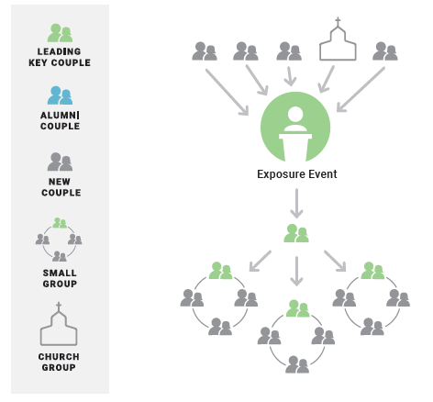
Accelerating Multiplication
It is possible to have an event ministry without a small-group ministry.
But it isn’t possible to have a dynamic small-group ministry without events.
Notes:
Script:
“We’ve been talking about Trusting God for Multiplication. How do we accelerate multiplication?
Your community’s catalytic event, say FamilyLife’s Weekend to Remember Getaway for example, can help create new groups.
However, consider a minimal-commitment exposure event. They are much easier for local leaders to organize and conduct. They give new couples a taste of the powerful principles and resources that FamilyLife offers. Exposure events can also effectively promote attendance at a future larger Catalytic event like a Getaway.”

Slide 14
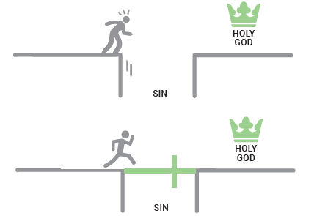
Small Groups – Outreach and Evangelism
As important as a good marriage is, it isn’t as important as having a relationship with Jesus Christ.
Effective evangelism in small groups requires more preparation and a non-religious approach.
Note: Global Outreach’s Small-Group Training manual has a large section on using small groups for outreach.

Slide 15
Role of Training Equipping leaders to grow the ministry
Events (Winning)
Date-night events
Low-commitment weekend events
Large events like Weekend to Remember
Small Groups (Building)
Marriage groups
Parenting groups
Women’s or men’s groups
Training (Sending)
Evangelism
Discipleship
Small-group facilitator
Speaker training

Slide 16
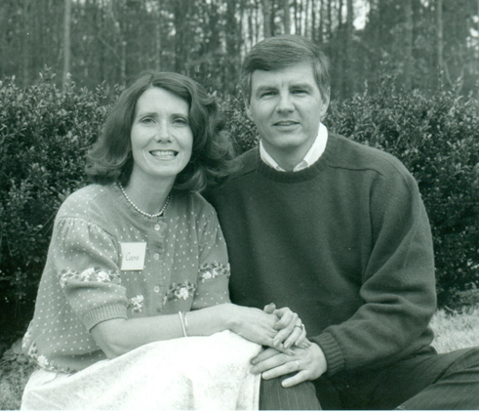
Kit and Drew Coons – An Ordinary Couple ? (led a highly evangelistic FamilyLife Local ministry with nearly 20,000 involved)
No, a well-trained ordinary couple.
Used Cru resources for decades before joining FamilyLife.
Completed AIT (Intensive Cru Training).
Completed two additional years of Cru Basic Sequential Training.
Attended IBS taught by Dennis Rainey.
Cru Staff in Nigeria and New Zealand.
At FamilyLife in 1991
Notes:
PRESENTER NOTES: Use this if you like. It demonstrates the potential of just one couple. You can also insert another couple or example that you are familiar with.
SCRIPT: “YOU CAN Make a Difference as a Couple! One key couple and about 250 volunteers led nearly 20,000 people to participate in a highly evangelistic FamilyLife Local Ministry.”

Slide 17
Two Aspects of Christian Maturity
The Character of Christ - How to Live
“ ‘Love the Lord your God with all your heart and with all your soul and with all your strength and with all your mind’ and, ‘Love your neighbor as yourself’ ” (Luke 10:27).
Ministry Skills - Abilities to Help Others
“Always be prepared to give an answer to everyone who asks you to give the reason for the hope that you have” (1 Peter 3:15).
“And He gave some as apostles, and some as prophets, and some as evangelists, and some as pastors and teachers, for the equipping of the saints for the work of service, to the building up of the body of Christ” (Ephesians 4:11-12).

Slide 18






Global’s Training Resources
Notes:
SCRIPT: FamilyLife Global has several training manuals available as free downloads on their website, www.familylifeglobal.com.

Slide 19

Warning
“Movements are messy.”
Dave Robinson
Cru | City
Key Leaders will have their own ideas and may not readily fit a one-size-fits-all slot.
“Let us not lose heart in doing good, for in due time we will reap if we do not grow weary” (Galicians 6:9).

