Slide 1




Date and time can go here.
Church name
Church address can
go here.
Contact information or registration information can go here

Slide 2

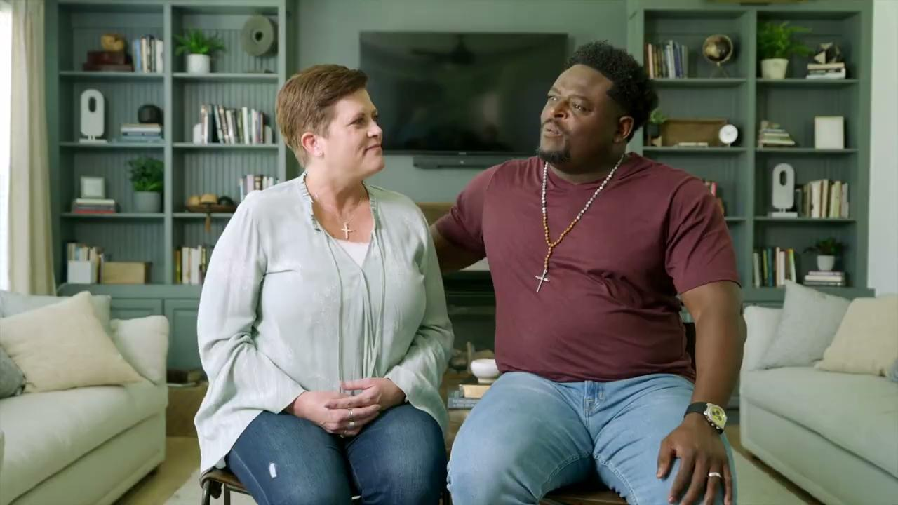


Slide 3



Husbands and wives each bring unique experiences
and perspectives.
This His and Hers Workbook Set offers an experience tailored to each spouse through reflections, challenge questions, and devotionals designed to enhance the distinct perspectives men and women bring to a marriage.

