Slide 1

Hidden Slide
Version 301 for Couples with FamilyLife Experience
Versions 101, 201, and 301 are extracted from FamilyLife Global’s Small-Group Training Manual
HIDDEN SLIDE
Notes:
This presentation assumes familiarity with FamilyLife’s small group strategy and basic methods. At least one of Small Group Trainings 101 or 201 is recommended as a prerequisite prior to viewing or presenting 301.
PRESENTER NOTES:
This slide and other hidden slides are not visible to the audience!
Your training presentation of this material will be far more effective if you will add illustrative stories like a Weekend to Remember speaker does. Jesus told story after story. Stories touch people’s hearts and are memorable. (i.e. Who can forget the parable of the Good Samaritan?)
The best stories are personal – even with the mistakes made and lessons learned. But stories can also be taken directly from the Bible or the experience of another couple. Stories need to be short and rehearsed beforehand. Jesus’ Good Samaritan parable is 179 words. Jesus never told a story longer than 500 words. More words are likely to bore your audience.

Slide 2
A deeper discussion on hosting small groups for the express purpose of sharing the Gospel
Notes:
PRESENTER NOTES: “Script throughout the presentation will be italicized and in quotes and underlined words are for emphasis.” while Presenter NOTES will be in BOLD
SCRIPT:
“In addition to building Christian marriages, FamilyLife’s Small Group approach is excellent for outreach to non-Christians or unchurched couples. Couples have a need for how-to principles that can improve their lives. FamilyLife can communicate these principles.
Ministering to families gets us into cultures and groups that other strategies are not as equipped to reach. When needs are met, hearts become open to Christ. In places where one-on-one sharing of God’s plan for life is not welcomed, practical actions that apply to life and marriage are received warmly. Receptivity to all spiritual truths frequently follows.”

Slide 3
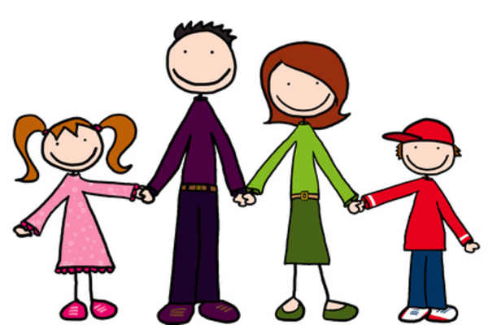
This Photo by Unknown Author is licensed under CC BY-SA
Notes:
PRESENTER NOTES: Letting the participants know something about YOU, the presenter, is important. It establishes credibility and rapport. Tell your own story here in a few minutes. (You may want to insert a personal picture above.)
Let the redeemed of the Lord tell their story. (Psalm 107:2)
SCRIPT:
(Insert your SHORT personal intro story here.)

Slide 4
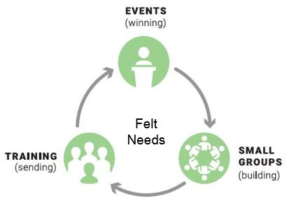
FamilyLife® Local Core Strategy
Events (Winning)
Small Groups (Building)
Training (Sending)
Notes:
SCRIPT:
“You may remember seeing this circle before. It is used to explain the ongoing process involving all three of FamilyLife’s key ministry elements: WIN | BUILD | SEND. Together the elements of Events, Small Groups, & Training support each other and give small group leaders confidence that FamilyLife has a proven plan that has been effective over the years.
As a movement develops in a community, the cycle can revolve faster and faster as well as grow bigger and bigger. AND the beauty of the cycle is that people can enter the cycle at any element and can move in either direction in their growth.
This training will be focusing on the second element: Small Groups (for building a movement). Specifically, we are going to focus on how to use Small Groups for Outreach in your communities to those that are far from God and far from the Church. Although events have been our primary winning activity, small groups are also very effective at winning or preparing hearts for an introduction to the biblical truths about Jesus.
PRESENTER NOTES: Participants need to know how what you are proposing fits into a broader strategy. Take some time to explain this circle. This slide adds an emphasis to FamilyLife/Cru’s WIN | BUILD | SEND ministry philosophy that is also represented by the diagram.

Slide 5
Why Think Evangelistically about Small Groups?
People need Jesus
FamilyLife’s small groups can
- build credibility for Scripture
- prepare hearts
- share the Gospel
“For the Son of Man came to seek and save the lost.”
Jesus
Notes:
SCRIPT:
“Let’s consider why you might start an intentional outreach-oriented small group. Most people in this generation in the United States are NOT church attenders and many do NOT have a personal relationship with Jesus.
Our primary reason for evangelism is that people need Jesus Christ for forgiveness of sin and eternal life.
FamilyLife’s small groups can build credibility for scripture, prepare hearts for reception of Christ, and share the gospel by several different means.”
“For the Son of Man came to seek and save the lost.” Luke 19:10 NIV
Additional scripture for reference.
“For God so loved the world that he gave his one and only Son, that whoever believes in him shall not perish but have eternal life. For God did not send his Son into the world to condemn the world, but to save the world through him. Whoever believes in him is not condemned, but whoever does not believe stands condemned already because they have not believed in the name of God’s one and only Son.” John 3:16-18 NIV
Great Commission – “Therefore go and make disciples of all nations, baptizing them in the name of the Father and of the Son and of the Holy Spirit, and teaching them to obey everything I have commanded you.” Matthew 28.19-20

Slide 6




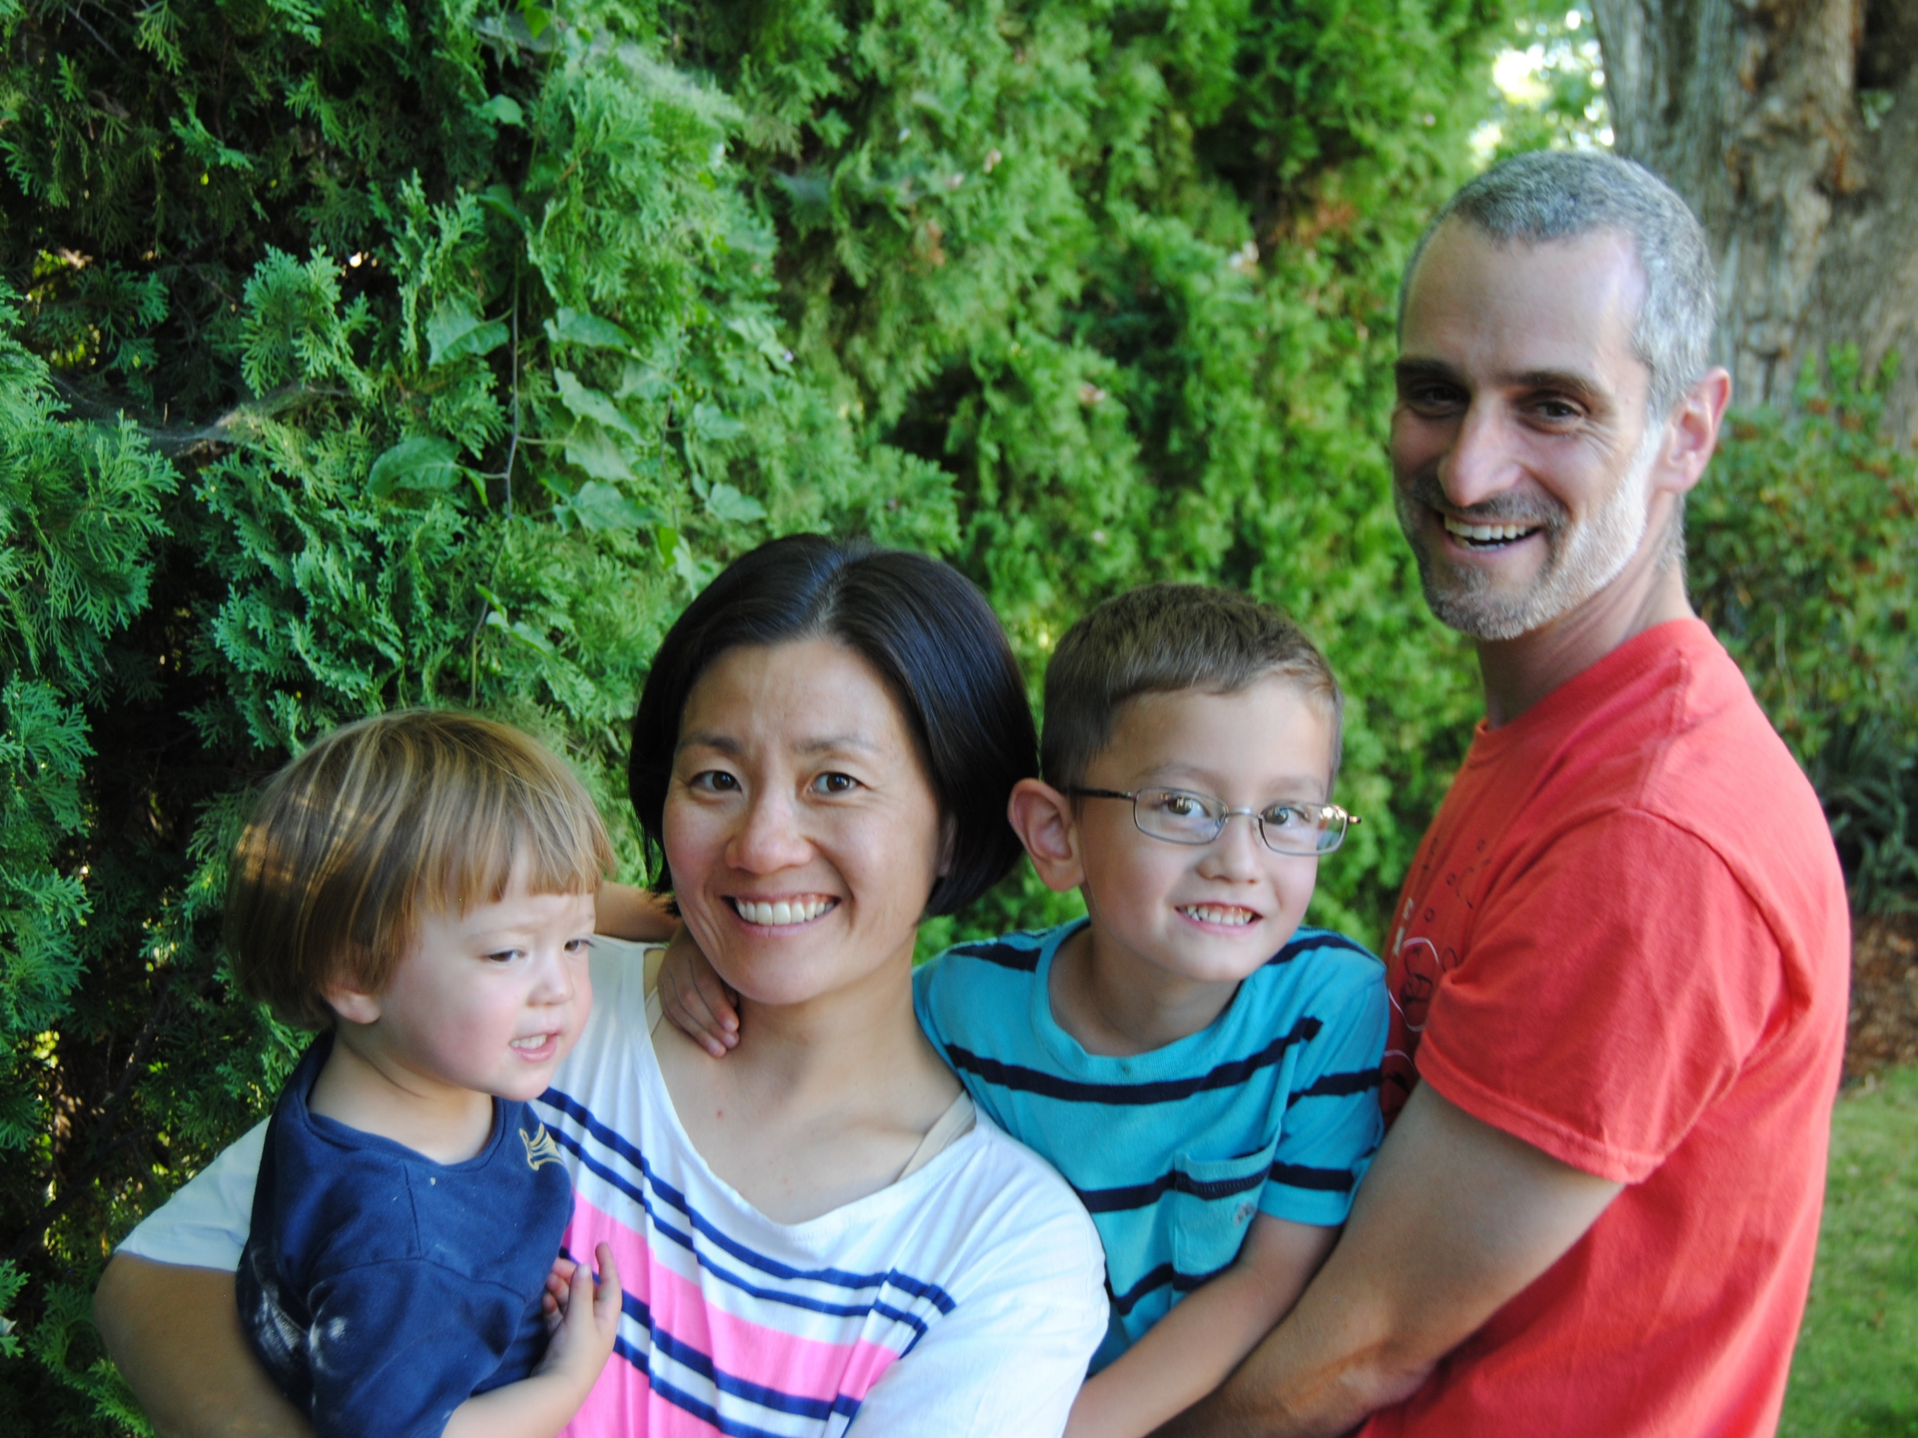


“Joe” & “Sally”
Notes:
SCRIPT:
“In fact, let’s start with an everyday “Joe” or “Sally,” a prospective group member or couple that you’d like to invite to be part of the group. He may be a friend, neighbor, co-worker, or a referral. She may be ““unacknowledged and unaffiliated” or may declare herself Catholic or Muslim or Agnostic or even Evangelical. Most likely though, Joe and Sally really don’t want to be in the group. Whether he is a nominal believer or she a regular church attender, they’d rather be doing anything than delving into personal issues, particularly about marriage. Especially if there are … “issues” …
Joe may have never heard the “good news” of the gospel of Jesus Christ. We cannot assume folks have a cultural understanding of faith, repentance, or even sin nowadays compared to folks in our culture just a couple of generations ago.
Just remember, you are trying to reach Joe as a friend, and being in a small group of friends talking about an issue that everyone seems to be dealing with, namely marital relationships, is a great “leveler” as you build trust. Today’s culture is not particularly friendly regarding marriage, but most people still dream of getting married.
Another important reminder is that as important as a good marriage is, it is not nearly as important as a relationship with Jesus. Hopefully, as Joe and Sally interact with the group, they will discover that they will never have “the best marriage” unless they invite Christ into their relationship.
Throughout the remainder of this training, please see everything through Joe and Sally’s eyes. Don’t worry about the “non-Joes.” If you host a quality activity interwoven with biblical principles, even all the non-Joes will be happy.”

Slide 7
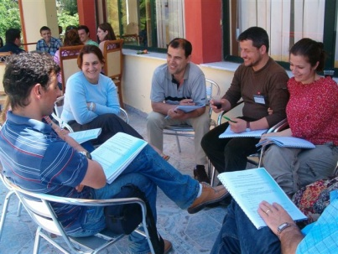
Christians in Outreach Groups
Christians can be included in outreach groups.
Christians have marriage needs too.
They are likely to share biblical applications.
They may learn how to reach non-Christians by your example
Notes:
PRESENTER NOTES: You can use Kit’s and Drew’s example below of narrow-mindedness for the gospel, if you like or something similar that you’ve experienced.
SCRIPT:
“BUT! Don’t exclude believers. Aim for 50/50 in your group, half of the participants can be believers while the other half (your target audience) are seekers, the curious, the agnostic, etc.
Christians can be included in outreach groups.
Christians have marriage needs too.
They are likely to share biblical applications.
They may learn how to reach non-Christians by your example.
Here’s a quote from a Drew & Kit, a leadership couple, that learned that they needed to include believers and non-believers alike to make their groups work.
“We started our small groups solely for the purpose of sharing the gospel. If you were already a follower of Christ, we didn’t want you to take up a seat. But we found that Christians always seemed to find a way into the group. The reason was simple: Their marriages had needs too.
So, we learned to take a balanced approach that included believers and non-Christians meeting together. We found that the Christians helped us immensely by setting an example of how to apply biblical principles to their marriage and family settings EVEN when struggling. Then, when couples came to Christ, they already had Christian friends. In addition, the Christians were also more ready to become leaders. They realized that they didn’t have to be “perfect.” In the process they helped to multiply the ministry. We were wrong in wanting to exclude Christians.”

Slide 8

Be real about your marriage.
Don’t fabricate or embellish.
People can spot a faker.
Don’t prejudge your invitation.
Notes:
PRESENTER NOTES: Impress on participants the importance that leaders must be fellow learners in an outreach group.
SCRIPT:
“Share your story, your experiences. It will help those group members who are seekers as well as other believers to see that Christians wrestle within their own marriages.
Be mindful of who you have invited, WHY you have invited them, and WHERE the group member is at in their spiritual journey. A marriage built on biblical principles will benefit. So there’s no need to act like your marriage is perfect. Just be real. It will actually serve as an advantage.
Listen, sometimes group members feel the need to “fake” a felt need as a pretext to sharing the gospel. For small groups to work for outreach and evangelism, leaders must not only care about sharing the gospel, but also care about the health of participants’ marriages. If couples sense duplicity, they will not be receptive when it comes to the claims of Christ. Be yourself, warts and all. When a couple experiences changed lives through principles taught in the Bible, they’ll be eager to hear about Jesus.

Slide 9
Small Groups → Permanent Life Change
“You make an impression on people from a distance. You make an impact on people when you get up close.”
(Dr. Howard Hendricks)
“The Weekend to Remember creates a desire to change. Small groups make that desire a reality.” (Jerry Wunder)
Notes:
SCRIPT: <From the slide>
“You make an impression on people from a distance. You make an impact on people when you get up close.” (Dr. Howard Hendricks)
Putting all a couple hears at a major event into practice can be like trying to swallow an elephant. BUT small-group studies are like cutting the elephant up into bite-sized pieces.
“The Weekend to Remember creates a desire to change. Small groups make that desire a reality.” (Jerry Wunder)
PRESENTER NOTE: This is a good place to insert an illustrative story. Your own life change through small groups would be best. Life changes you have observed can also be very effective. Remember, no more than 500 words.
This slide demonstrates the importance and the effectiveness of the small-group component of the strategy.

Slide 10
HOW and WHY This Module is Different From FamilyLife’s Other Small-Group Training Sessions
Learn to use minimal-commitment events to interest non-Christians or unchurched couples.
Identify several ways to use small groups for outreach.
Learn tips for leading outreach groups.
Discuss a clear and organized way to share the gospel.
Notes:
SCRIPT: <From the slide>
• We’ll talk about how to use minimal-commitment events to interest non-Christians or unchurched couples.
•We’ll identify several ways to use small groups for outreach.
•We’ll learn tips and some best practices for leading outreach oriented groups.
•We’ll discuss a clear and organized way to share the gospel.
PRESENTERS NOTES:
These are four bullets from page 33 of the FamilyLife Small Groups training manual to describe WHY this training presentation is different than the other presentations (101 & 201)
The challenge we face is that many professing Christians are so immersed in religious culture, politics, their church affairs, and social values that they are unable to interact with non-Christians about spiritual things in an effective manner.
We must coach them to avoid political issues, religious jargon, and symbolism. Don’t talk about divisive issues that would take the focus off marriages and ultimately the essentials of the gospel. Effective leaders will avoid religious words or phrases that non-Christians would not understand. Even prayer may not be appropriate in some groups.

Slide 11
Assumptions
You’ve gone through one of FamilyLife’s Small Group Training.
You’ve successfully led FamilyLife’s small groups before and understand the discussion format.
Notes:
SCRIPT:
“Also, we’re making some assumptions as we dig further into this training.
One: You’ve gone through one of FamilyLife’s Small Group Training presentations; traditional small training or training for First-Timers.
Two: You’ve successfully led FamilyLife’s small groups before and understand the discussion format and what it takes to strategize, prepare and invite guests to your small group gathering.”
PRESENTER NOTES: The reason we focus on FamilyLife’s Small Group Training is that there are lots of different ways to lead small groups—some not conducive to creating an open environment. We take the approach that providing a Discussion Format feels more “open and inviting” to those exploring a topic through faith-based approach rather than a Lecture Format.

Slide 12
YOU Can Make a Difference as a Couple
Your Marriage, Your Church, Your Community
Working as a Team Couple
Allowing Differences to Make You Stronger as a Team
Taking Your Relationship with God, and Your Marriage, to a Higher Level
HIDDEN SLIDE
Notes:
PRESENTER NOTES:
If a large part of the participants have not attended either 101 or 201, then I’d use this slide. If most have had 101 or 201, then leave it hidden.
The purpose of this slide is to impart a vision about what God can accomplish with you working together as a couple. Tell a personal illustrative story like a Weekend to Remember speaker would. Stories about being more effective as a team are both marriage enriching and relate directly to ministry. Five hundred words (about 3 minutes) maximum.
SCRIPT:
<Insert a short personal story here.>
“The Small Groups Training Manual has an excellent section on pages 6-9 covering these points:
Working as a Team Couple
Allowing Differences to Make You Stronger as a Team
Taking Your Relationship with God, and Your Marriage, to a Higher Level”
************************************
Note: This identical slide is in SG101 and 201. In every presentation, helping couples’ marriages to the next level is essential.

Slide 13
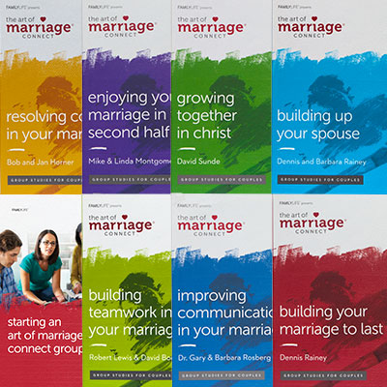

Starting a FamilyLife Small Group
HomeBuilders® / AOM Connect Series / Couples Studies
More than 2.5 million distributed
20 different topics
47 languages
HIDDEN SLIDE
Notes:
PRESENTER NOTES:
If a large part of the participants have not attended either 101 or 201, then I’d use this slide. If most have had 101 or 201, then leave it hidden.
Emphasize starting with the felt needs that the Connect Series meets. The new materials are good for leadership development.
Possibly ask the audience if anyone has used any of these materials before. Pick one or two individuals and allow them 30 seconds each to elaborate 1 reason that they liked the study they used.
SCRIPT: “Non-believers are surprisingly ready to make friends with dedicated Christians and are often open to learning things that work. The key is in focusing on a commonly held value: healthy, rewarding marriages.”

Slide 14
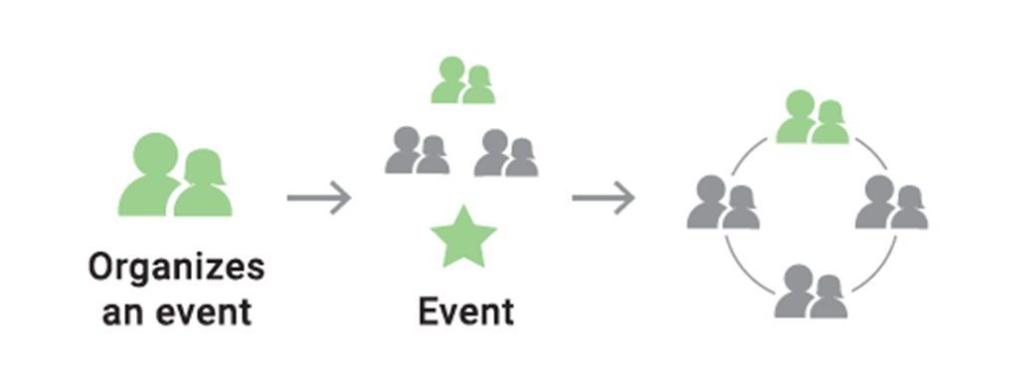
The Process
Exposure
Event
Notes:
SCRIPT:
Getting non-Christians into a group usually requires an entry event to give them a taste of what to expect.
A couple feels led to organize an exposure event. (Jesus used large-group meetings (events) and created interest by performing miracles to accelerate the ministry. FamilyLife offers a natural momentum–building occasion with the Weekend to Remember Getaway and other types of local and smaller exposure events. The event should be fun and meaningful to the participants.)
The couple and a team of volunteers can then strategize, promote, and host an exposure or catalytic event of some type. At the event, give a response opportunity to indicate a willingness to try a limited-duration small group.
As part of the strategy, contact the couples after the event who have indicated an interest in a small group. Organize those interested couples into an acceptable time and place to meet. Neutral locations such as a home are the best. Remember that Joe is our top priority! Prioritize the time and location around the non-Christian couples' preferences.
NOTES: Lots of churches and groups are looking for someone who can give an entertaining message with some practical content. They may organize an event for you. An exposure event containing a marriage enrichment talk can be a tremendous door opener to promote small-group discipleship or evangelistic studies. A seminar designed in this way can lead into a small-group ministry. These seminars could have the greatest potential for serving smaller communities that can’t host a large catalytic event of their own. This is the essence of the village and synagogue strategy. (Small-Group Training manual, pages 55-56).
“And Jesus was going about all the cities and the villages, teaching in their synagogues, and proclaiming the gospel of the kingdom, and healing every kind of disease and every kind of sickness.” —Matthew 9:35
Jesus also went to the people in their villages and synagogues (Luke 8:1, Luke 13:22, Mark 6:6, Matthew 11:1, Matthew 9:35, Matthew 4:23, Mark 1:14). He also sent His disciples to the people (Luke 9:6, Luke 10:1, Mark 6:7-12, Matthew 28:19-20, Acts 1:8).

Slide 15
Minimal-Commitment (Exposure) Events
Cookout (backyard, park, lake)
Christmas cookie exchange
Luncheon with a testimony
Super Bowl party
Easter egg hunt
Volleyball or other sports activity
Home dessert with a testimony
Catered dinner with speaker
Dinner party with testimony
Valentine party or banquet
Short marriage or parenting seminar
Parenting talk at a community center
Book club
Dart/pool league
Fishing/hunting weekend
Houseboat party
Hmmmm … what else could I/we do???
Notes:
SCRIPT:
Minimal-commitment events are effective to introduce yourselves to non-believers. Fun activities and meaningful principles will encourage them to be open to an invitation to a small group. Some examples:
Cookout (backyard, park, lake)
Christmas cookie exchange
Luncheon with a testimony
Super Bowl party
Easter egg hunt
Volleyball or other sports activity
Home dessert with a testimony
Catered dinner with speaker
Dinner party with testimony
Valentine party or banquet
Short marriage or parenting seminar
Parenting talk at a community center
Book club
Dart/pool league
Fishing/hunting weekend
Houseboat party

Slide 16
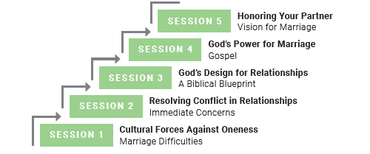
Couples Relationship Seminar A FamilyLife Resource
Approved by FamilyLife’s content team and executive leadership
Designed to be non-threatening and attract non-Christians
Perfect for Exposure Events
Easy to deliver
Speaking notes and jokes provided
Designed for “Joe”
Notes:
PRESENTER NOTES: This is a FamilyLife resource that can help key couples offer exposure events or speak to churches or other groups. It is available, including a copy-ready manual, through FamilyLife’s Global Department. The gospel is clearly shared.
SCRIPT:
“One way you could gather folks together is to meet their felt need. The Couples Relationship Seminar is available at no cost as a FamilyLife resource, with talk outlines, handouts, activities, projects, and speaking notes. These flexible sessions could be offered to communities and churches in a variety of settings. Any of the sessions on the right side of your slide can be delivered independently and not necessarily in order. Each session is designed as a forty-five minute presentation to meet a particular need.
Approved by FamilyLife’s content team and executive Leadership
Designed to be non-threatening and attract non-Christians
Perfect for Exposure Events
Easy to deliver
Speaking notes and jokes provided
Designed for “Joe” (At one seminar, 50% of the participants made a first-time decision for Christ.)
Talk to me after our session if this is of interest.”

Slide 17

Training for Trainers
Training Module
FamilyLife’s Speaker Training can help you to train more effectively
AND be equipped to conduct non-WTR exposure events.
Notes:
SCRIPT: There are two aspects to Christian maturity. The first and most important is godly character—the degree to which we have allowed God to develop the likeness of Jesus in our lives. The character of Christ will manifest itself in us by our love for God, our love for our neighbors, and our obedience to His commandments (Matthew 22:37-39, John 14:21). Bible knowledge and understanding are important steps by which God will develop in you the likeness of Christ. As ministry leaders, we urge you to engage in regular Bible study and to meditate on God’s Word (2 Timothy 3:16-17). While many types of Bible study can help you mature as a Christian, FamilyLife’s Couples Studies® and Art of Marriage Connect series® are uniquely suited to help you mature along with your closest neighbor, your spouse.
The second aspect of Christian maturity relates to ministry skills. God often uses natural abilities, such as having a good voice for singing. But Jesus Himself made it abundantly clear in the parable of the talents that our Master expects His servants to increase their abilities. Unfortunately, many people who know the Bible and truly love Jesus have never been used by God to do great things in His work. In some cases, they have not developed ministry skills God can use. We hope to equip you to multiply your talents by developing skills necessary to minister to families. We offer “how-to” training resources to conduct the FamilyLife Outreach Strategy and to fully utilize the resources FamilyLife provides.” (Strategy and Resource Manual pp 33-34)
One great thing about using small groups as a platform to share Christ is that those who receive Christ are already in a Bible study! Your effectiveness in sharing the gospel, answering questions, and conducting follow-up can increase with training and experience. FamilyLife® and Cru® offer many resources to develop your ministry skills in this area. This is just one of several advanced training curriculums available.

Slide 18
Leading Outreach Small Groups
Lead a small group with non-Christians in the same manner as a regular group, with special attention to the following tips.
Be patient
Protect
Create a non-threatening environment
Notes:
SCRIPT:
“The following tips are designed to help non-Christians fit into a Bible-application environment that may feel unusual to them. Leading a small group with non-Christians can happen in the same manner as leading a churched small group. Just pay attention to some of these basics.
<CLICK>
a) Be patient. Couples trained in the world’s values will have very non-biblical ideas. Don’t correct them. For example, if someone says something like, “God led me to get divorced,” continue to the next question in the study without comment. Let God’s Spirit use your example and the Scriptures in materials to touch his/her heart, and our God will do it, in His time.
<CLICK>
b) Protect. Don’t allow well-meaning Christians who may join your group to “witness” or direct comments to your possibly non-believer target couples in a confrontational or condescending manner. If necessary, speak to the Christian privately and urge patience. Assure them that God will use the materials and our personal applications to prepare hearts for your gospel presentation. At all costs avoid a “them vs us” division between Christians and non-Christians in the group.
<CLICK>
c) Create a non-threatening environment. You may wonder how a church could threaten anyone, but it can. Outreach is most successful in a neutral place perhaps your home. On one occasion a pastor organized a seminar and located it in a bar. Non-believers attended and some came to Christ. In addition, occasionally Christians unconsciously try to establish a spiritual pecking order by sharing spiritual matters outside the scope of the study. This can create a threatening environment for those who may need the study the most.

Slide 19
Leading Outreach Small Groups (cont)
Don’t teach
Have fun!
Be flexible
Respect privacy
Notes:
Don’t teach—share. Be careful not to appear as an authority. On occasion, couples have become defensive rather than receptive when they thought an expert might judge them. The best way to lead is by generously sharing your own mistakes and what you are learning.
<CLICK>
Have fun! FamilyLife studies can be strong medicine for many couples. Make friends and encourage laughter to break the tension. Couples having fun are likely to put the lessons into practice and to continue coming. Limit the meeting to an hour and a half plus social time. Having fun together is more important than finishing all the questions.
<CLICK>
Be flexible. These couples are precious to God, so much so that He died for them. Sacrifice your own convenience to arrange meeting times, childcare, etc., for them. Leaders successful at outreach have sometimes organized an entire study around the availability of one non-believer couple.
<CLICK>
Respect privacy. Seeing God working in a couple’s lives is exciting. You are likely to want to let others share your joy and perhaps pray for the group. Nothing will anger some couples more than to hear from people who are not part of the small group saying that they are praying for them. If this happens, the couple will know you’ve been talking about them outside the group. Keep what is shared in your group and who is in the group private.

Slide 20
Leading Outreach Small Groups (cont)
Start and end on time
Work together as a team
Don’t accidentally embarrass anyone
Don’t force people to talk
Notes:
Start and end on time. Many, particularly men, feel uncomfortable, especially at first, making small talk. Some topics will be painful for couples. Don’t extend the sessions or they may not return. Also, some couples will come later and later if you delay starting. Start promptly when you say you are going to. Couples rarely drop out of a group after one topic. An exception is when a group leader consistently allows sessions to go overtime,
<CLICK>
Work together as a team. Your spouse may be more sensitive about needs in the group than you are. Discuss who needs encouragement, etc., with your spouse between sessions. Your teamwork will be a powerful testimony to the group about the relationship between Christ and the Church.
<CLICK>
Don’t accidentally embarrass anyone. Many people have little Bible knowledge. For example, don’t call on someone to read unless you’re certain they’ve found the verse. Many times, educated professional people have sat with their Bible open to Psalms, because they had no idea how to find John.
<CLICK>
Don’t force people to talk. This is even more important than in a regular churched small group. When someone who has been reluctant to talk speaks, verbally agree with them. Positively refer to their comment later during the discussion. This usually encourages a quiet person to become more of a contributor.

Slide 21
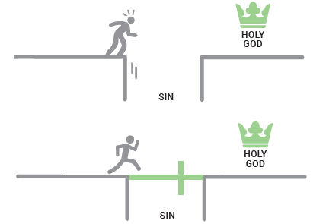
Remember …
As important as a good marriage is, it isn’t as important as having a relationship with Jesus Christ.
Effective evangelism in small groups requires more preparation and a non-religious approach.
Notes:
SCRIPT:
“As important as a good marriage is, it isn’t as important as having a relationship with Jesus Christ.
Effective evangelism in small groups requires more preparation on your part and a non-religious approach. This involves avoiding religious jargon or coercion and looking for natural ways to share the gospel, such as in the context of the small-group session or through your personal experiences.”

Slide 22
Sharing the Gospel
You can share the gospel several different ways:
Many of the studies have an explanation of the gospel in the appendix or part of the study questions.
Give your personal testimony within the discussion context.
Set up a private appointment with a couple.
Invite the participants to an event where the Gospel will be shared
Notes:
SCRIPT: “Participating in a group will start to create an interest in spiritual things for those who get involved. Making scriptural applications will open their receptivity to the claims of Christ. It is critical that they clearly understand what the claims of Christ are.
You can share the gospel several different ways:
It’s recommended to wait until about the fifth session to weave in the gospel story; once the group has coalesced and relationships have been established. Some groups may be ready before that. However, by then couples are likely to see improvements in their marriages. Simply announce at the beginning of the fifth session, “This week we’re going to spend a few minutes in the appendix of your book.” Read through the entire gospel, saving any questions or discussion until you’ve finished. Allow a few minutes for discussion.
A personal testimony like the one demonstrated in Acts 26:1-23 can be very effective (Paul’s testimony to King Agrippa). Since small groups are a discussion, a personal testimony is a very natural and easy way to share the gospel during a session. It is a personal explanation of the circumstances surrounding your conversion and the changes Christ has produced in your life. A well-designed testimony of two to three minutes will seem a natural part of group dynamics. Few people will feel that they have been “preached at” or “witnessed to.”
Treat a private appointment same as the first option, except meet with each couple outside the group. Be prepared with one or two different approaches depending on the conversation flows. I will share two of those approaches in just a minute.
Andrew, the disciple of Jesus, did an effective job of evangelism. All he had to do was to invite his brother Peter to a meeting. You will develop close relationships with the couples in your group. As your friends, they are much more likely to attend an event where Christ is clearly shared, especially if it is a marriage-oriented outreach. Plus, if you are the speaker at said event, your words will carry a LOT of weight because they already know your story.
There are a couple of tools that FamilyLife and its’ parent organization, Cru, have designed to make it easier to include an explanation of the gospel into almost any conversation.”

Slide 23





The Four “a digital tool for a digital crowd”
KNOWGOD.COM/EN/THEFOUR
Notes:
SCRIPT:
“One of those readily available gospel-sharing resources is offered by Cru called the “The Four”. Let me demonstrate how easy it could be. Take out your phones. Type in KNOWGOD.COM/EN/THEFOUR. Feel free to explore while I walk thru the screens in this presentation.
PRESENTERS NOTES: hyperlink to Cru’s God Tools Gospel Presentation - knowgod.com/en/thefour
You can refer to the Small-Group Training manual to supplement your understanding of how to use a small-group approach to “outreach and evangelism.” (pp 33-44) There are numerous resources available through FamilyLife / Cru to help you share your faith and even use your marriage story as a bridge to sharing the gospel! Be conscious of the group you are sharing with and where they are at in their faith journey.
CRU TOOLS - www.cru.org/us/en/train-and-grow/share-the-gospel.html

Slide 24


Your Marriage can Present the Gospel
Effective evangelism in small groups requires more preparation and a non-religious approach.
Notes:
Script:
“Another approach to effectively sharing the gospel is by purposefully sharing your personal marriage story in a SHORT easy to follow conversation. This approach was recently taught at FamilyLife’s 2020 National Volunteer Summit. It includes four themes to help believers introduce the gospel in just a few minutes. Those four themes are The Dream, The Fall, The Hope and finally The Response. There is a fifth theme to challenge folks to share their story with others called The Mission. Note the subtitle below: “Effective evangelism in small groups requires more preparation and a non-religious approach.
Be prepared by understanding one of these approaches and practice it ahead of time. Seriously, PRACTICE IT!”
PRESENTERS NOTES: Great spot to insert a personal story using this approach. Remember, the purpose of the first three elements is to get you to the point of sharing the gospel.
FamilyLife’s Marriage Gospel Cards:
https://drive.google.com/file/d/1w4EzIkLIQOe8SC2SDjpbOLnlKL3vhVh7/view
FamilyLife’s Marriage Gospel Card Instructions:
https://drive.google.com/file/d/1G36D3u7Sek2rB1jJrmYwTjMYFK4eCTw9/view

Slide 25

Trust God for Miracles
Notes:
SCRIPT:
“Be persistent as you begin your ministry, and don’t allow failure to discourage you. The most mature faith, the faith God uses, is prepared for failures.
Perhaps one of the best-known success stories from the Bible is when the shepherd boy David fought the giant Goliath. 1 Samuel 17:40 records that David took five stones with him to face the giant. Most assume David hit Goliath on the first shot. But Scripture does not say it was the first stone. Perhaps the second, third, fourth, or fifth stone struck. Which stone doesn’t matter. The point is that David’s faith was such that he was prepared to fire until he brought the giant down.
So it is with us using FamilyLife small groups to reach out to those with the greatest needs in our communities. We need to be prepared to make several attempts at starting a group or organizing events. God seems to require that type of faith to work His greatest miracles.“

