Slide 1

Hidden Slide
Version 201 for Couples with FamilyLife Experience
Versions 101, 201, and 301 are extracted from FamilyLife Global’s Small-Group Training Manual
HIDDEN SLIDE
Notes:
PRESENTER NOTES: This slide is not visible to the audience!!!
Your training presentation of this material will be far more effective if you will add illustrative stories like a Weekend to Remember speaker does. Jesus told story after story. Stories touch people’s hearts and are memorable. (i.e. Who can forget the parable of the Good Samaritan?)
The best stories are personal – even with the mistakes that are made, and the lessons learned. But stories can also be taken directly from the Bible or the experience of another couple. Stories need to be short and rehearsed beforehand. Jesus’ Good Samaritan parable is 179 words. Jesus never told a story longer than 500 words. More words are likely to bore your audience.

Slide 2
Notes:
PRESENTER NOTES: “Script throughout the presentation will be italicized and in quotes” while NOTES will be in BOLD and underlined words are for emphasis.
SCRIPT: “Small groups are the most versatile resource FamilyLife offers. When there is a large audience, the speakers speak in general terms and cover a multitude of principles. Many parts may not be relevant to a couple’s specific circumstances. Other parts are relevant to a couple, but while covering so many things, the speakers cannot go into as much depth or application as a couple needs.
In a small group, the discussion can focus on the needs of the group members. Some couples have led many groups using the same topics with different groups of people. These couples have observed that different groups have different personalities as they focus on principles and applications most relevant to the needs of the members.” (Small-Group Training Manual, p1)

Slide 3
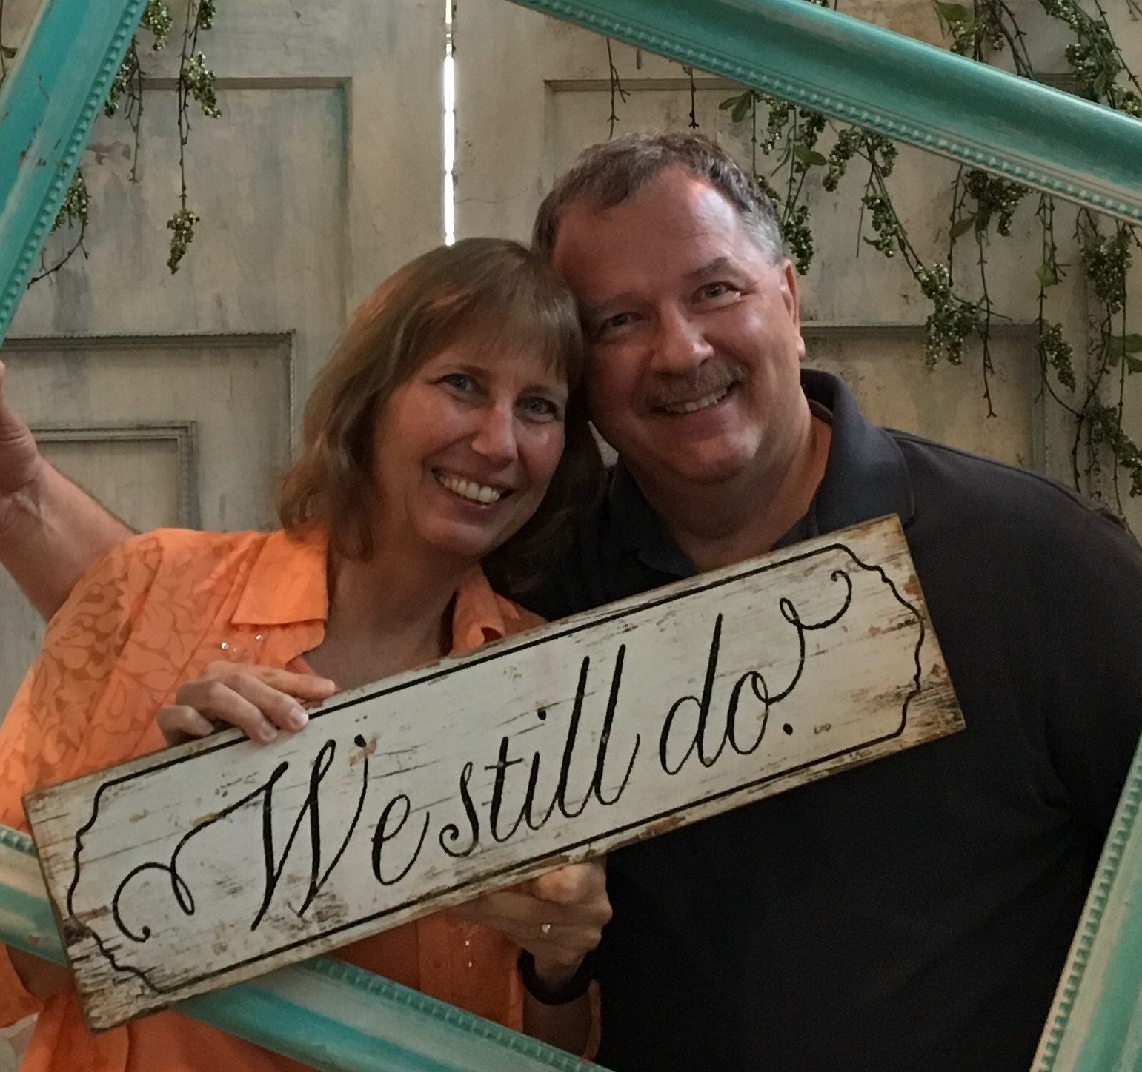
Notes:
PRESENTER NOTES: Letting the participants know something about YOU, the presenter, is important, It establishes credibility and rapport. Tell your own story here in a few minutes.
Let the redeemed of the Lord tell their story. (Psalm 107:2)
SCRIPT: “Insert your SHORT personal intro story here.”

Slide 4
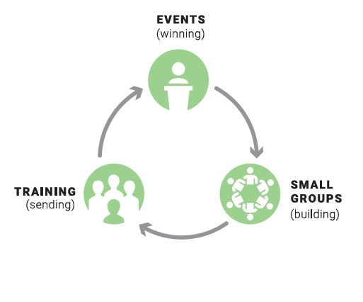
FamilyLife® Local Core Strategy
Events (Winning)
Small Groups (Building)
Training (Sending)
Notes:
PRESENTER NOTES: Participants need to know how what you are proposing fits into a broader strategy. Take some time to explain this circle.
SCRIPT: “This circle is an ongoing process involving all three of FamilyLife’s key ministry elements. Together the elements support each other and give small group leaders confidence that FamilyLife has a proven plan that has been effective over the years.
As a movement develops the cycle can revolve faster and faster as well as grow bigger and bigger. AND the beauty of the cycle is that people can enter the cycle at any element and can move in either direction
This training will be focusing on the second element; Small Groups (for building a movement)”

Slide 5
FamilyLife® Local Core Strategy
Events (Winning)
Small Groups (Building)
Training (Sending)
Notes:
SCRIPT: “Small groups are an integral part of this ministry model because it is the best place to step towards someone’s felt need with a small group of people who will ‘build’ into your marriage and those in your group”

Slide 6
Jesus’ Example and Local Ministry Model
 | Jesus (This is what the disciples understood they were to do as they applied Jesus teachings - Matt 28:19-20) |  | FamilyLife Local Core Ministry
Events | “He began teaching in synagogues” Luke 4:15 “Large crowds were gathering to hear him” Luke 5:15 | → WIN | Exposure outreaches Church events Couples Relationship Seminar Weekend to Remember
Small Groups | Luke 6:1, 6:13, 8:51 Matthew 9:35 Many times Jesus met with groups of seekers | → BUILD | Small Group Women’s Bible studies and conferences
Training | Luke Chapters 9 and 10 Involving disciples in ministry | → SEND | HomeBuilders leadership Cru materials Leadership conferences Involving volunteers in ministry
Notes:
PRESENTER NOTES: No need to cover this slide in detail. Just show the slide to demonstrate biblical and historical basis for the strategy. This is very important for some couples. It can be given in the handout.

Slide 7
Small Groups → Permanent Life Change
“You make an impression on people from a distance. You make an impact on people when you get up close.”
(Dr. Howard Hendricks)
“The Weekend to Remember creates a desire to change.
Small groups make that desire a reality.” (Jerry Wunder)
Notes:
PRESENTER NOTES: This slide demonstrates the importance and the effectiveness of the small group component of the strategy.
SCRIPT: <From the slide>
“You make an impression on people from a distance. You make an impact on people when you get up close.” (Dr. Howard Hendricks)
Putting all a couple hears at a major event into practice can be like trying to swallow an elephant. BUT small-group studies are like cutting the elephant up into bite-sized pieces.
“The Weekend to Remember creates a desire to change. Small groups make that desire a reality.” (Jerry Wunder)
NOTE: This is a good place to insert an illustrative story. Your own life change through small groups would be best. Life changes you have observed can also be very effective. Remember no more than 500 words.

Slide 8
YOU Can Make a Difference as a Couple
Your Marriage, Your Church, Your Community
Working as a Team Couple
Allowing Differences to Make You Stronger as a Team
Taking Your Relationship with God, and Your Marriage, to a Higher Level
Notes:
PRESENTER NOTES: The purpose of this slide is to impart a vision about what God can accomplish with you working together as a couple. Tell a personal illustrative story like a Weekend to Remember speaker would. Stories about being more effective as a team are both marriage enriching and relate directly to ministry. Five hundred words (about 3 minutes) maximum.
SCRIPT: <Insert a short personal story here.>
“The Small Groups Training Manual has an excellent section on pages 6-9 covering these points.
Working as a Team Couple
Allowing Differences to Make You Stronger as a Team
Taking Your Relationship with God, and Your Marriage, to a Higher Level”
PRESENTER NOTES: This identical slide is in SG101, 201, and 301. In every presentation helping couples’ marriages to the next level is essential.

Slide 9


Starting a FamilyLife Small Group
HomeBuilders® / AOM Connect Series / Couples Studies
More than 2.5 million distributed
20 different topics
47 languages
Notes:
PRESENTER NOTES: Emphasize starting with the “felt needs”: those needs are the titles in the Connect Series. The 3 newer resources are also great for leadership development.
Possibly ask the audience if anyone has used any of these materials before. Pick one or two individuals and allow them no more than 30 seconds each to elaborate 1 reason that they liked the study they used.

Slide 10
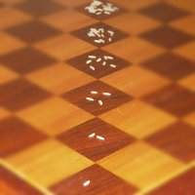
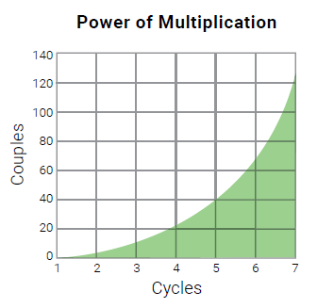
Trusting God for Multiplication
An ordinary piece of paper folded just 24 times will be over a mile thick. That’s the power of multiplication.
2x2⁶ = 64
Notes:
PRESENTER NOTES: The Small Group Training Manual discusses multiplication on pages 45-59. Read through that section. You’ll notice that there are several multiplication stories included there.
SCRIPT: “Trust God for the generational growth of a movement based on small groups.
For instance, an ordinary piece of paper folded just 24 times will be over a mile thick. That’s the power of multiplication. For those of you who think with your left brain, the logic side, think about this equation to go with the chart on the right. After 6 generations of equipping couples to find someone to disciple and they in turn do the same you’ve reached 64 people. 10 generations = 1,024. and so on…..
Like a rocket taking off, multiplication can seem slow at first. Then it starts to accelerate.”
***************************************
<Presenter NOTE: Insert a personal multiplication, or multi-generational, story here. OR a different example could be the legend of the origin of the game of chess.
“There's a famous legend about the origin of chess that goes like this. When the inventor of the game showed it to the emperor of India, the emperor was so impressed by the new game, that he said to the man
"Name your reward!"
The man responded,
"Oh emperor, my wishes are simple. I only wish for this. Give me one grain of rice for the first square of the chessboard, two grains for the next square, four for the next, eight for the next and so on for all 64 squares, with each square having double the number of grains as the square before."
The emperor agreed, amazed that the man had asked for such a small reward - or so he thought. After a week, his treasurer came back and informed him that the reward would add up to an astronomical sum, far greater than all the rice that could conceivably be produced in many many centuries!”

Slide 11

Two approaches to multiplying a movement of small groups
Organic small groups do NOT grow bigger and then divide like an amoeba or go viral like a cute cat video.
FamilyLife Small Groups multiply when leaders are involved in the ongoing process.
Notes:
SCRIPT:
“Everybody wants multiplication, but few ever see it happen. A major reason is misunderstanding how multiplication occurs.
Organic small groups do not grow bigger and then divide like an amoeba or go viral like a cute cat video.
FamilyLife small groups multiply when leaders are involved in the events | small groups | training strategy represented in the circle diagram earlier in this training. You may have individuals that “catch the big picture vision” early on and decide to start their group. POOF! YOU’VE MULTIPLIED.”
As a leader you want to be looking for potential leaders in your group and challenging them to consider leading a group of their own. Reassure them that you are available to coach them along the way and there are additional training modules available. FamilyLife is continuing to develop additional training to coach you on how to coach them should you choose to do that .

Slide 12
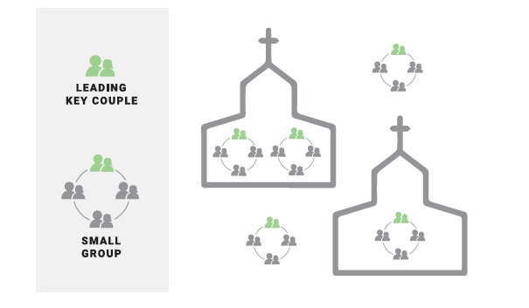
Trusting God for Multiplication
Always respect pastors.
Offer to serve churches – in the context of marriage and family small groups
Don’t be negligent in ministering to Christians.
Notes:
PRESENTER NOTES: Please emphasize respecting pastors and serving churches on their terms. Not seeking what churches can do for FamilyLife.
SCRIPT:
“Recognize that pastors are in a role instituted by God and care deeply about the folks they are called to shepherd. Have a posture of service as you hear their vision for their congregation.
Small Groups in the church program structure are good and CAN change lives. Naturally, we tend to build our small groups around people that look like us and act like us. That’s a great place to start!
But, the strongest multiplication could take place with groups that are spending time with couples from different churches or from different socio-economic-ethnic backgrounds.
Couples seem to focus better on applying the principles as they interact with others that are not “like themselves”. Being from different churches, each couple will bring a different perspective to the conversation. They also have a pool of friends, you don’t know, to potentially invite to future events or groups.”
We can also come alongside a church that wants to start or modify their small group strategy. Here you will find opportunities to serve the church as well as broaden your outreach to those outside the church. Those folks who are “far from God and far from the Church”.
Hold that posture that we are NOT replacing the local church but rather serving the local church. Helping pastors to equip their congregation in discipling others. (2Tim 2.2, Eph 4.12)” That attitude will open many doors of ministry where you can serve.

Slide 13
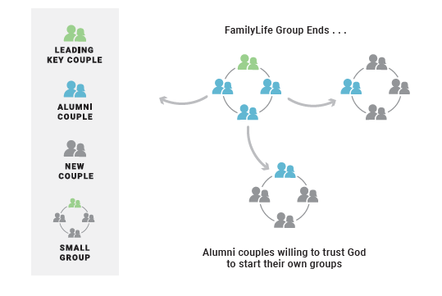
Trusting God for Multiplication
Groups ending may be part of God’s plan
Stay in touch with leaders and potential new leaders
Be patient with others AND yourselves.
Notes:
SCRIPT:
“The end of a small group may even be part of God’s plan. Jesus said, “Unless a grain of wheat falls into the earth and dies, it remains by itself alone, but if it dies, it bears much fruit” (John 12:24).
Most small groups end before they multiply. The reason is that couples normally come to a group with needs. Once that need is met, they may lose interest. Later when new needs surface they may start their own group; even years afterward. And that’s okay. We never encourage groups to end. But when they do, we look forward to seeing who may emerge as future leaders from that group. (SGM p 48).
Active multiplication of small groups looks like bubbling oatmeal. (SGM p 50)” READ the story
Organic ministry growth may look VERY different from what you might expect. Be patient with your group members. Stay engaged in their lives. Trust that the Spirit of God WILL accomplish HIS purpose.

Slide 14
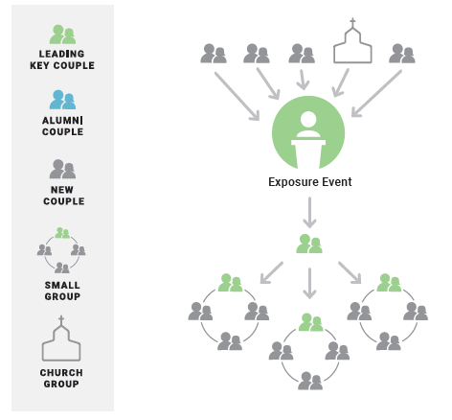
Accelerating Multiplication
An event ministry without a small-group ministry is possible.
But a DYNAMIC movement based on small-group ministry without events isn’t likely.
Notes:
Script:
“We’ve been talking about Trusting God for Multiplication. How do we accelerate multiplication?
Your community’s catalytic event, say FamilyLife’s Weekend to Remember Getaway for example, can help create new groups.
However, consider a minimal-commitment exposure event. They are much easier for local leaders to organize and conduct. They give new couples a taste of the powerful principles and resources that FamilyLife offers. Exposure events can also effectively promote attendance at a future larger Catalytic event like a Getaway.”

Slide 15
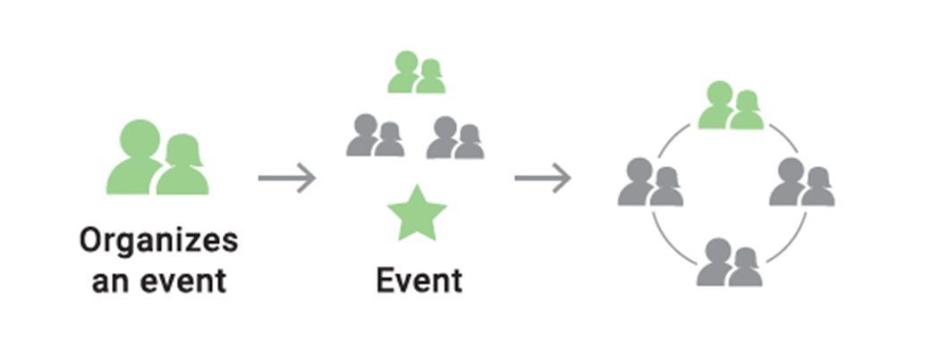
Minimal-Commitment (Exposure) Events are Effective to Start New Groups
• Cookout (backyard, park, lake)
• Christmas cookie exchange
• Luncheon with a testimony
• Super Bowl party
• Easter egg hunt
• Volleyball or other sports activity
• Home dessert with a testimony
• Catered dinner with speaker
• Neighborhood project
• Dinner party with testimony
• Valentine party or banquet
• Short marriage or parenting seminar
Notes:
SCRIPT:
“Here are some examples of minimal exposure events. Frequently, some sort of event requiring minimal initial commitment is most effective in starting new groups. The event should be non-threatening and fun. If the event is fun and meaningful, many guests will want to respond to your invitation to be part of a small group and may even tell others.
As you plan an event, remember how important each person is to God. Make the occasion a first-class event. That alone will communicate to your guests that you value them. (And they should be important to us!) Jesus died for each person who comes through your door. Building relationships before and during an event is an important key to a positive response. Pray ahead of time, then relax and enjoy the event. ☺ Tension in the host will be evident and will reduce the effectiveness of the event.
Avoid political issues, religious jargon, and symbolism. When you’re seeking to involve unchurched couples or those who are unsure of their relationship with God, it is important to speak their language. Don’t talk about divisive issues that would take the focus off their relationships. Be sure to avoid religious words or phrases that they would not understand. Playing gospel music or praise and worship music may be distracting to some folks. Even prayer (except to receive Christ if the opportunity arises) may not be appropriate at some exposure events. Think it through and creatively explore some of these events or create one of your own. Remember, a key way to build a movement is to think about connecting with those folks that are “far from God and far from the Church.”

Slide 16
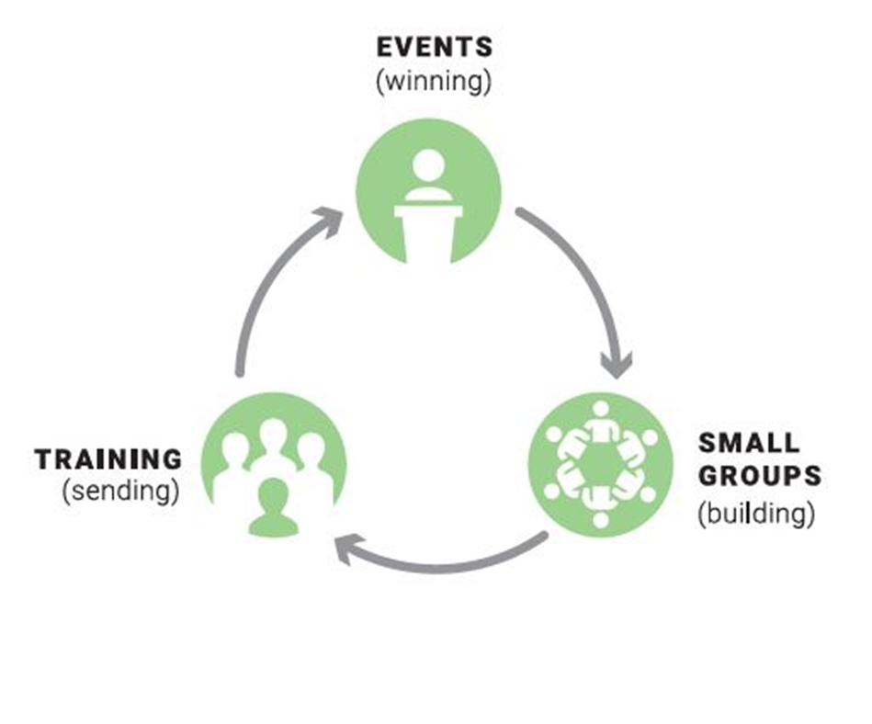
Multiplication Requires New Leaders
Give leadership opportunities during each group
Coach those potential leaders
Create fun social activities
Provide training
Notes:
Presenter notes:
There are several training sessions that will be available in the near future to assist in training and coaching new leaders.
SCRIPT:
“Multiplication requires new leaders. Therefore, observe couple(s) in your group, that COULD be encouraged to consider leading their own small group.
Remember, training is not a one-shot effort. You can initially plant the idea of multiplication by providing leadership opportunities for group members on a volunteer basis (read a passage, lead a discussion element, etc). The volunteer is never the one you would have chosen. But that may be part of God’s plan. For example, when a person leads a session, and is successful, then everyone else in the group thinks, ‘If he (or she) can do this, I can too’.”
Give leadership opportunities during each group session
Provide leadership with good connecting skills such as a bit of coaching or even a few best practices if you are using social media interaction.
You can even create fun, engaging social activities

Slide 17

Training for Trainers
Training Module
FamilyLife’s Speaker Training can help you to train more effectively
AND be equipped to conduct non-WTR exposure events.
HIDDEN SLIDE
Notes:
SCRIPT: “There are two aspects to Christian maturity. The first and most important is godly character—the degree to which we have allowed God to develop the likeness of Jesus in our lives. The character of Christ will manifest itself in us by our love for God, our love for our neighbors, and our obedience to His commandments (Matthew 22:37-39, John 14:21). Bible knowledge and understanding are important steps by which God will develop in you the likeness of Christ. As ministry leaders, we urge you to engage in regular Bible study and to meditate on God’s Word (2 Timothy 3:16-17). While many types of Bible study can help you mature as a Christian, FamilyLife’s Couples Studies® and Art of Marriage Connect series® are uniquely suited to help you mature along with your closest neighbor, your spouse.
The second aspect of Christian maturity relates to ministry skills. God often uses natural abilities, such having a good voice for singing. But Jesus Himself made it abundantly clear in the parable of the talents that our Master expects His servants to increase their abilities. Unfortunately, many people who know the Bible and truly love Jesus have never been used by God to do great things in His work. In some cases, they have not developed ministry skills God can use. We hope to equip you to multiply your talents by developing skills necessary to minister to families. We offer “how-to” training resources to conduct the Global Outreach Strategy and to fully utilize the resources FamilyLife provides.” (Strategy and Resource Manual pp 33-34)

Slide 18


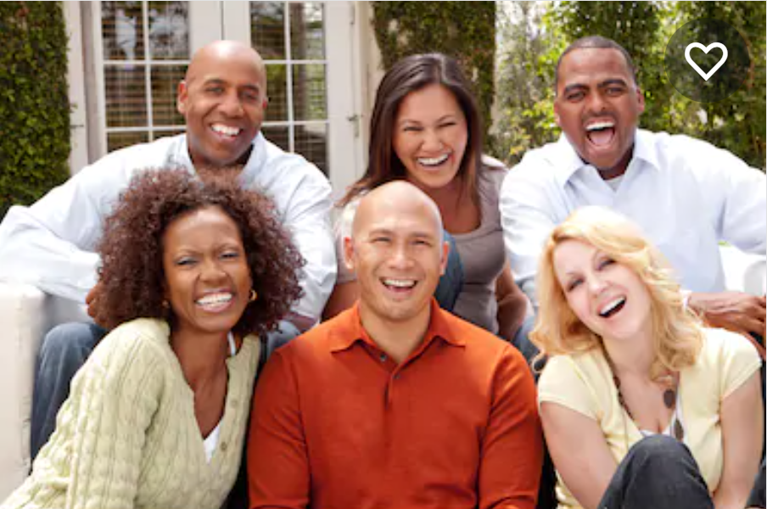
Key Characteristics to look for in Identifying New Leaders
Godly Character
Ministry Skills
Notes:
SCRIPT: “There are two aspects to Christian maturity. The first and most important is godly character—the degree to which we have allowed God to develop the likeness of Jesus in our lives. The character of Christ will manifest itself in us by our love for God, our love for our neighbors, and our obedience to His commandments (Matthew 22:37-39, John 14:21). Bible knowledge and understanding are important steps by which God will develop in you the likeness of Christ.
As ministry leaders, we urge you to engage in regular Bible study and to meditate on God’s Word (2 Timothy 3:16-17). While many types of Bible study can help you mature as a Christian, FamilyLife’s Couples Studies® and the Art of Marriage Connect series® are uniquely suited to help you mature along with your closest neighbor, your spouse.
The second aspect of Christian maturity is related to ministry skills. God often uses natural abilities, such having a good voice for singing. But Jesus Himself made it abundantly clear in the parable of the talents that our Master expects His servants to increase their abilities no matter what level of “skill” they bring to the endeavor.
Unfortunately, many people who know the Bible and truly love Jesus have never been used by God to do great things in His work. In some cases, they have not developed ministry skills God can use. We hope to equip you to multiply your talents by developing skills necessary to minister to families. We offer “how-to” training resources to conduct the FamilyLife Outreach Strategy and to fully utilize the resources FamilyLife provides.” (Strategy and Resource Manual pp 33-34)

Slide 19

Working with New Leaders Training Module
FamilyLife’s Working with Volunteers training can help you to find and equip new small-group leaders.
HIDDEN SLIDE
Notes:
SCRIPT: In order to multiply small groups key couples will need to learn how to recruit, motivate and lead volunteers. This additional training available through FamilyLife® offers proven insights to assist you.
The Two Most Important Scriptures to Remember when Working with Volunteers:
So in everything, do to others what you would have them do to you, for this sums up the Law and the Prophets (Matthew 7:12).
Do nothing out of selfish ambition or vain conceit. Rather, in humility value others above yourselves (Philippians 2:3).
Have the attitude that volunteers are even more important as people versus what they can do to help you.

Slide 20



A Warning about Multiplication
Satan understands multiplication too. He knows that an effective multiplication ministry has the potential to change many lives. He will attack at the source … YOU.
This is a major reason why each of us MUST continually take our marriages to a higher level. And we need to support one another as a “couple team”.
Notes:
PRESENTER NOTES: – Pick the picture that would best fit your personality and style.
This is the slide that explains the reason why FamilyLife insists on injecting advanced marriage principles into training!
SCRIPT: Satan understands multiplication too. He knows that an effective multiplication ministry has the potential to change many lives. He will attack at the source … you.
This is a major reason that we MUST continually take our marriages to a higher level. And we need to support one another as a couple team.
Be persistent through the challenges and don’t allow failures to discourage you. Each of us are stretched at some point in our growth. Like a muscle being exercised so are your ministry skills as they develop. The most mature faith, the faith God uses, is prepared when failures occur but also see the reason for the challenge; to cause us to grow.
Perhaps one of the best-known success stories from the Bible is when the shepherd boy David fought the giant Goliath. 1 Samuel 17:40 records that David took five stones with him to face the giant. Most assume David hit Goliath on the first shot. But Scripture does not say it was the first stone. David was prepared to fire until he brought the giant down.
So it is with us, using small groups to reach out to our communities. Be prepared to make several attempts at starting a group or organizing events. God seems to require that type of faith to work the greatest miracles.”

Slide 21
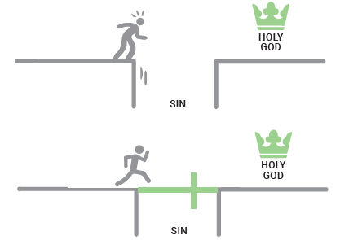
WHAT IF you could use your
Small Groups for Outreach?
As important as a good marriage is, it isn’t as important as having a relationship with
Jesus Christ.
Notes:
PRESENTER NOTES: You can refer to the Small Group Training Manual here as a close to encourage future training. SGM pp 33-44 covers outreach and how to have an evangelism mindset while using small groups to multiply your movement in a market. We’ll also cover these in detail in Small Groups 301.
SCRIPT:
“As we wrap up, I want to remind you of a key aspect of discipling others. As important as a good marriage is, it isn’t as important as having a relationship with Jesus Christ.
Effective evangelism in small groups requires more preparation on your part and a non-religious approach. This involves avoiding religious jargon or coercion and looking for natural ways to share the gospel, such as in the context of the small-group session or through your personal experiences.”
Therefore, as we continue to grow together you should consider how to use your small group setting to move folks closer to Jesus and even be willing to talk about their personal faith journey. We are actively developing specific training on how to initiate small group gatherings with those who may be “far from God and far from the Church”. We also have a module specifically designed to help you with this aspect should God be calling you to invite others to explore what the Bible has to say about everyday marriage and parenting principles.”

Slide 22
Q & A
Notes:
SCRIPT: “We covered a lot of basic information regarding small groups. We’ve also reinforced some of the best practices to host and facilitate a group. Let’s take some time to see if you have any questions.”

Slide 23
Hidden slide for PRESENTER overview notes on animation and handouts
HIDDEN SLIDE
Notes:
PRESENTER NOTES: Manually advancing animations with a click are a cosmetic enhancement allowing the presenter to focus on a point before moving to the next point. They are entirely up to the PRESENTER personal preference and are not necessary. In fact, if there is too much animation using multiple styles it is VERY distracting and can take away from the presentation. However, once the presentation is given often enough and the presenter can time their delivery to coincide with the content the animated text / pictures can be VERY effective.
There is a duplicate of this presentation with animations embedded as an example.
*************************************
You can print out this presentation as a handout in several formats. If you are offering the slides as a touchpoint for interactivity and note taking you may want to choose the 3 slide per page format. As a caution it is recommended to also print out a NOTES page in case something happens and you are unable to use the slide deck itself.

