Slide 1

Hidden Slide
Version 101 for Couples without FamilyLife Experience or new to hosting small groups
Versions 101, 201, and 301 are extracted from FamilyLife Global’s Small-Group Training Manual
HIDDEN SLIDE
Notes:
PRESENTER NOTES: This slide and other hidden slides are not visible to the audience!
Your training presentation of this material will be far more effective if you will add illustrative stories like a Weekend to Remember speaker does. Jesus told story after story. Stories touch people’s hearts and are memorable. (i.e. Who can forget the parable of the Good Samaritan?)
The best stories are personal – even with the mistakes that are made, and the lessons learned. But stories can also be taken directly from the Bible or the experience of another couple. Stories need to be short and rehearsed beforehand. Jesus’ Good Samaritan parable is 179 words. Jesus never told a story longer than 500 words. More words are likely to bore your audience.

Slide 2
An introduction to hosting small groups
Notes:
PRESENTER NOTES: “Script throughout the presentation will be italicized and in quotes” while NOTES will be in BOLD and underlined words are for emphasis.
SCRIPT: “Small groups are the most versatile resource FamilyLife offers. When there is a large audience, the speakers speak in general terms and cover a multitude of principles. Many parts may not be relevant to a couple’s specific circumstances. Other parts are relevant to a couple, but while covering so many things, the speakers cannot go into as much depth or application as a couple needs.
In a small group, the discussion can focus on the needs of the group members. Some couples have led many groups using the same topics with different groups of people. These couples have observed that different groups have different personalities as they focus on principles and applications most relevant to the needs of the members.” (Small-Group Training Manual, p1)

Slide 3
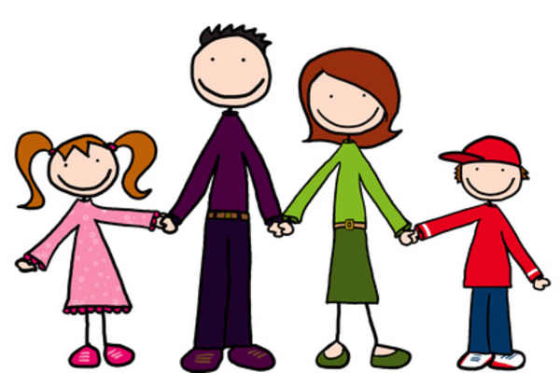
This Photo by Unknown Author is licensed under CC BY-SA
Notes:
PRESENTER NOTES: Letting the participants know something about YOU, the presenter, is important. It establishes credibility and rapport. Tell your own story here in a few minutes. (Please replace the picture placeholder with a recent photo of you and your family.)
Let the redeemed of the Lord tell their story. (Psalm 107:2)
SCRIPT: (Insert your SHORT personal intro story here.)

Slide 4
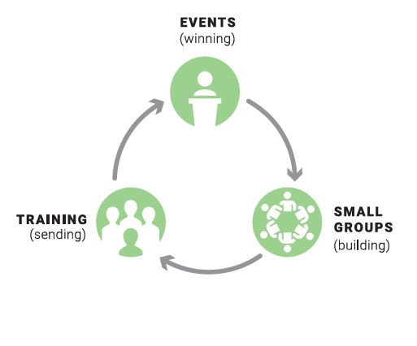
FamilyLife® Local Core Strategy
Events (Winning)
Small Groups (Building)
Training (Sending)
Notes:
PRESENTER NOTES: Participants need to know how what you are proposing fits into a broader strategy. Take some time to explain this circle.
SCRIPT: “This circle is an ongoing process involving all three of FamilyLife’s key ministry elements. Events. Small Groups. Training. Together the elements support each other and give small group leaders confidence that FamilyLife has a proven plan that has been effective over the years.
As a movement develops the cycle can revolve faster and faster as well as grow bigger and bigger. AND the beauty of the cycle is that people can enter the cycle at any element and can move in either direction.

Slide 5
FamilyLife® Local Core Strategy
Events (Winning)
Small Groups (Building)
Training (Sending)
Notes:
SCRIPT:
“This training will be focusing on the second element; Small Groups (for building a movement).
Small groups are an integral part of this ministry model because it is the best place to step towards someone’s felt need with a small group of people who will ‘build’ into your marriage and those in your group”

Slide 6
Small Groups were an Integral Part of Jesus’ Strategy
Although Jesus sometimes spoke to large audiences, most of the time he met with smaller groups, especially his disciples. To them he gave deeper instruction. (numerous scriptures)
Jesus met with smaller groups in homes, at synagogues, and during meals. (numerous scriptures)
Jesus met with seekers, discussing the Kingdom of God and answering their questions. (John 1:45-51, Matt 19:16-22, Luke 10:38-42, John 4:1-30)
Notes:
SCRIPT:
“Scripture records Jesus speaking to large audiences. But if you study through the four gospels, you’ll find Jesus spent most of his time with smaller groups. Even when he spoke directly to individuals, likely a group was involved because the conversation was recorded.
Although Jesus sometimes spoke to large audiences, most of the time he met with smaller groups, especially his disciples. To them he gave deeper instruction. (numerous scriptures)
Jesus met with smaller groups in homes, at synagogues, and during meals. ‘Jesus went to the people in their homes, villages, and synagogues.’ (Matthew 9:35)
Jesus met with seekers, discussing the Kingdom of God and answering their questions. (John 1:45-51, Matt 19:16-22, Luke 10:38-42, John 4:1-30)
He also sent His disciples to the people. (Luke 10:1).
Principle to catch here is → Although large crowds sought him out, this more personal get-close-to-people-in-smaller-gatherings method was the core of Jesus’ ministry.”

Slide 7
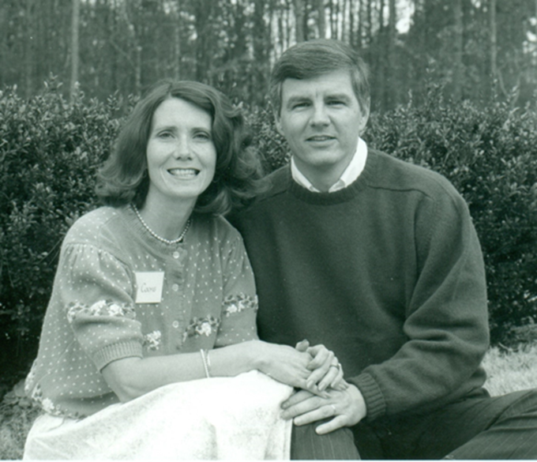
Dare to Trust God with Changed Lives
One key couple and about 250 volunteers led nearly 20,000 people to participate in a highly evangelistic FamilyLife Local Ministry.
“We saw God start a movement from the ministry we built.”
Notes:
PRESENTER NOTES: Use this if you like. It demonstrates the potential of just one couple, Kit and Drew Coons. You can also insert a more current couple or example that you are familiar with.
SCRIPT: “YOU CAN Make a Difference as a Couple! One key couple and about 250 volunteers led nearly 20,000 people to participate in a highly evangelistic FamilyLife Local Ministry.”

Slide 8
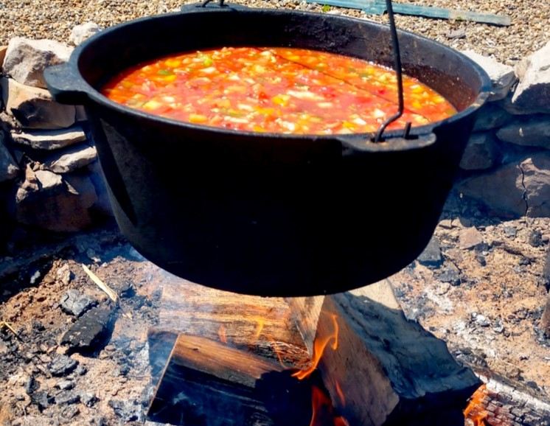
Small Groups Can Be Like Making Stone Soup
Group members are amazed to discover that EVERYONE has something to contribute.
Notes:
PRESENTER NOTES: Do not take for granted that everyone understands this dynamic. Many people think that “Bible study” means lecture. READ THE STORY.
SCRIPT: “A FamilyLife group should be like making stone soup. Three soldiers were walking back to their homes after the war. As they passed through a village along the road, they asked for some food. The villagers answered, “Sorry, but the war was hard here, too. We don’t have any food to spare.” Then the soldiers said, “I guess we’ll have to make soup from stones.” “You can’t make soup from stones,” the villagers replied. The soldiers would not be dissuaded. “If someone will loan us a pot, we’ll prove it.” They filled the pot with water and then built a fire around it. Then each of them selected a smooth stone from the creek and put it in the pot. They began to stir. Of course, the villagers gathered to see these dummies try to make soup from stones. As they stirred the pot, one soldier remarked, “Stone soup just doesn’t taste right without a little salt. I just wish we had some salt to show how good it can be.” One of the villagers volunteered, “I’ve got a little extra salt.” They added the salt to the pot. In a few minutes, another soldier remarked, “My mother used to put a few carrots in her stone soup. It was the best. I just wish that we had a few carrots.” “I’ve got some extra carrots!” a villager cried out. And so it went. They added cabbage, potatoes, and meat. Then they shared their soup with the entire village. Everyone had a wonderful time and ate their fill. The soldiers resumed their journey. And for years afterwards, the villagers marveled that you really could make soup out of stones.
That’s the way these small groups are supposed to work. None of us are experts on marriage. But every one of us has learned about things that work and things that don’t. We can each add to the soup.
(Small-Group Training, pages 23-24.)
The Stone Soup story is a memorable way to explain the most effective style of gathering in a group. It can also add interest to how easy it can be to lead a group. Like in the story, the sessions each start with simple questions to which anybody can contribute. Nobody knows everything about marriage. But everybody knows something—things that work, things that don’t. Couples will apply principles to their lives when they help to explain them.”

Slide 9
YOU Can Make a Difference as a Couple
Your Marriage, Your Church, Your Community
Working as a Team Couple
Allowing Differences to Make You Stronger as a Team
Taking Your Relationship with God, and Your Marriage, to a Higher Level
Notes:
PRESENTER NOTES: The purpose of this slide is to impart a vision about what God can accomplish with you working together as a couple. Tell a personal illustrative story like a Weekend to Remember speaker would. Stories about being more effective as a team are both marriage enriching and relate directly to ministry. Five hundred words (about 3 minutes) maximum.
SCRIPT: <Insert a short personal story here.>
“The Small Groups Training Manual has an excellent section on pages 6-9 covering these points.
Working as a Team Couple
Allowing Differences to Make You Stronger as a Team
Taking Your Relationship with God, and Your Marriage, to a Higher Level”
PRESENTER NOTES: This identical slide is in SG101, 201, and 301. In every presentation helping couples’ marriages to the next level is essential.

Slide 10
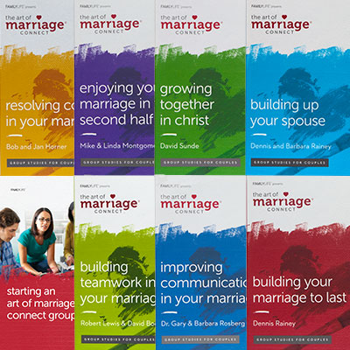

Starting a FamilyLife Small Group
Notes:
PRESENTER NOTES: Emphasize starting with the “felt needs”: that the Connect Series addresses (7 titles on the left). The 3 new resources on the right are great for leadership development.
Possibly ask the audience if anyone has used any of these materials before. Pick one or two individuals and allow them 30 seconds each to elaborate 1 reason that they liked the study they used
Script:
“The Art of Marriage Connect® Series
More than 2.5 million distributed
20 different topics
47 languages
Here’s a best practice that might help:
If you are just starting a group or just coming out of a catalytic event like the Weekend to Remember, it is recommended that you consider using “Building Your Marriage to Last”. As you can see there are also additional studies available that explore numerous other “felt needs”; finances, communication, resolving conflict, etc.

Slide 11
FamilyLife Small-Group Benefits
Stimulates and guides meaningful conversation between husband and wife
Doesn’t require the leader to be an expert, but rather a facilitator
Requires only a short-term commitment
Needs no preparation for the actual study from participants
Emphasizes practical application in the projects
Versatile for use in small groups, Sunday school classes, neighborhood outreaches, and weekend retreats and other creative gatherings
Provides mutual encouragement and accountability
Offers a variety of practical topics
Teaches participants HOW to live the Christian life
Gives couples the opportunity to minister together
Notes:
PRESENTER NOTES: Although benefits are important, beware of spending too much time on this slide. Just note a couple (no more than 5 benefits) Let your audience read the rest on their own or in their notes.
Stimulates and guides meaningful conversation between husband and wife
Doesn’t require an expert Bible teacher, but rather a facilitator
Requires only a short-term commitment
Needs no preparation for the actual study from participants
Emphasizes practical application in the projects
Versatile in small groups, Sunday school classes, neighborhood outreaches, and weekend retreats
Provides mutual encouragement and accountability
Offers a variety of practical topics to choose from
Teaches participants more about how to live the Christian life
Gives couples the opportunity to have a ministry together as leaders

Slide 12

Small Group Time-Saving Benefits
Investment in your own marriage
Learn more about the Bible and its message
Improve your character in Christ
Have fun! Make some lifelong friends
Serve in, or through, your church
Do your kids a favor. ☺
Notes:
PRESENTER NOTES: This slide answers a major objection to joining a group, the unasked question “What’s in it for me?”. Nobody is looking for something else to do. Read through the time-saving benefits.
SCRIPT:
“Here are some time saving benefits that your small group participants will experience.
Investment in your own marriage
Learn more about the Bible and its message
Improve your character in Christ
Have fun! Make some lifelong friends
Serve in, or through, your church
Do your kids a favor. ☺
You can do all these things in just one activity, participating in a FamilyLife small group.

Slide 13
Small Group Leader Preparation
Commit to making the study a high priority
Discuss how much you will share about your own marriage
You set the example
Decide how you will share the responsibilities of leadership
Discuss how you will prepare for the session, contacting group members, and even extending hospitality
Commit to pray
Notes:
SCRIPT:
(From page 13 of the Small-Group Training)
“As a group leader you’ll need to make a few preparations. You should start with this list and we’ll elaborate on them a bit more in the next few slides
As a couple, commit to each other and to God to make the study a high priority for the six to eight weeks it will take to complete one study.
Discuss how much you will share about your own marriage.
Don’t expect others to speak openly, respectfully and transparently unless you set the example as leaders.
Decide how you will share the responsibility for the various aspects involved in leading the group.
You should also discuss how you will prepare for the session, contacting group members, and even extending hospitality.
Commit to pray regularly for the couples in your group.
Then address these following decisions.”

Slide 14
– Decide What Type of Group
STEP 1
GROUP TYPE | ADVANTAGES | WHOM TO INVITE
Follow-Up to an event | Captures the enthusiasm Dynamic Group Vision for future small groups | Alumni of a FamilyLife event Alumni from other marriage events You can also invite others who are on your heart but haven’t attended any event
Notes:
PRESENTER NOTES: The next four slides in STEP 1 reveal different types of groups. The purpose is to broaden the participants’ ideas about the types of groups possible and give them flexibility.
Be careful not to spend too much time on these four types of groups. They will be in their notes!
SCRIPT: “GROUP TYPE : Follow-Up to an event
Advantages of hosting this type of group
Captures the enthusiasm from the event
Likely will be a dynamic group with couples from different backgrounds
These are the best groups to invite into considering hosting a small group themselves
WHOM TO INVITE BEYOND the folks who indicated their interest AT THE EVENT
Reach out to recent alumni of a FamilyLife event
Alumni from other marriage events in your community
You can also invite others who are on your heart but didn’t attend any event

Slide 15
– Decide What Type of Group
STEP 1
GROUP TYPE | ADVANTAGES | WHOM TO INVITE
Church (Cell Groups Sunday school A new group Weekend retreat) | Serving the church is a high priority Lots of contacts Childcare | Church members and guests Ask leaders of existing groups if they could use FamilyLife Couples Studies for a season Outsiders may be willing to join if the church members don’t pressure them to other activities
Notes:
SCRIPT:
“GROUP TYPE : Church based Small Group
Life Groups – Community Group - Cell Groups
Sunday school
A new members group
Weekend retreat for couples
Advantages of hosting this type of group
Serving the church is a high priority
Potentially a lot of contacts
Frequently childcare is available
WHOM TO INVITE
Church members and guests
Ask leaders of existing groups if they could use FamilyLife Couples Studies for a season
Outsiders may be willing to join if the church members don’t pressure them to other activities”

Slide 16
– Decide What Type of Group
STEP 1
GROUP TYPE | ADVANTAGES | WHOM TO INVITE
Neighborhood and Friends | Capitalizes on relationships you have already developed Deeper friendships formed among participants Likely to meet deep needs among those you care about | EVERY couple you know—don’t rule anybody out Ask alumni of previous groups to attend and invite their friends and neighbors
Notes:
SCRIPT:
GROUP TYPE : Neighborhood and Friends
Advantages of hosting this type of group
Capitalizes on relationships you have already developed
Deeper friendships formed among participants
Likely to meet deep needs among those you care about
WHOM TO INVITE BEYOND the folks who indicated their interest AT THE EVENT
Reach out to recent alumni of a FamilyLife event
Alumni from other marriage events in your community
You can also invite others who are on your heart but didn’t attend any event

Slide 17
– Decide What Type of Group
STEP 1
GROUP TYPE | ADVANTAGES | WHOM TO INVITE
Outreach or Evangelistic | Effective to introduce others to Christ Unexpressed personal needs | Usually a prior minimal-commitment gathering or exposure event is VERY helpful Coworkers, neighbors, social acquaintances. Seed the group with a few godly and discrete Christians
Notes:
SCRIPT:
“GROUP TYPE : Outreach or Evangelistic
Training is recommended to lead this type of group. See the session titled “Using FamilyLife Small Groups for Outreach” in the Small-Group Training manual. There is also a supplemental module available in the FamilyLife training library.
Advantages of hosting this type of group
Effective to introduce others to Christ
Unexpressed personal needs
WHOM TO INVITE
A prior minimal-commitment gathering or exposure event is VERY helpful
Coworkers, neighbors, social acquaintances, etc.
Seed the group with a few godly and discrete Christians who understand the mission for this type of group”

Slide 18

– Invite Couples to Participate
STEP 2
A personal invitation is nearly always best. (Pulpit announcements can work for church groups.)
Tell the benefits of small groups.
Promise a limited duration of the group, usually six or twelve weeks, depending on whether you meet every week or every other week.
4-6 couples is ideal. Never start a group with fewer than 4 couples.
Notes:
SCRIPT: “Organizing a group is not as difficult as it may seem. The family is one of the hottest topics people think about these days. FamilyLife offers a variety of practical study topics to interest couples. Most topics usually have about 7 sixty-minute sessions. That way couples won’t have to make an indefinite commitment. Six to eight couples is idea. It is highly suggested that you NOT start a new group with less than four couples. More or fewer couples will not allow the group to develop the dynamics that make groups special. Generally, couples should not be added to the group after the second session. New couples can be added when you start a new topic. (Pg 12)”

Slide 19
Whenever possible, let the participants decide.
– Set a Schedule
STEP 3
SCHEDULE OPTIONS | PROS | CONS
Weekly | A study can be completed in a few weeks Keeps interest level high | May create pressure on group members’ schedules Requires frequent childcare arrangements
Every Other Week | Allows more time to complete the project on the alternate week | Lengthens time needed to complete study Without a regular night reserved, couples forget and schedule something else that night
Notes:
PRESENTER NOTES: The next three slides in STEP 3 give the participants some ideas on scheduling options. We strongly advise emphasizing weekly meetings. But be careful to not use too much time on these choices, just like STEP 1.
SCRIPT:
“Schedule Options: Weekly or Biweekly
Weekly PROs
A study can be completed in a few weeks
Keeps interest level high
Weekly CONs
May create pressure on group members’ schedules
Requires frequent childcare arrangements
*****************
BI-Weekly PROs
Allows more time to complete the project on the alternate week
BI-Weekly CONs
Lengthens time needed to complete study
Without a regular night reserved, couples forget and schedule something else that night

Slide 20
– Set a Schedule
STEP 3
SCHEDULE OPTIONS | PROS | CONS
Monthly | Existing group already scheduled | Rarely develops good group chemistry Social group mentality
Varied | Takes everyone’s schedule into account | More effort to coordinate Increases risk of not completing the study Rarely successful
Notes:
Schedule Options: Monthly or Varied
Monthly PROs
Can work for an existing group already having a monthly meeting scheduled
Monthly CONs
Rarely develops the kind of chemistry that makes groups dynamic
Frequently this type of becomes just a social group
*****************
(Varied meeting times are just sessions that are scheduled one at a time, depending on participants’ calendars)
Varied PROs
Takes everyone’s schedule into account
Varied CONs
Takes more work to coordinate
Increases risk of not completing the study
Rarely successful

Slide 21
– Set a Schedule
STEP 3
SCHEDULE OPTIONS | PROS | CONS
Weekend Retreat Option | Involves couples that are unlikely to make a longer-term commitment Doesn’t require outside speakers Low-cost alternative to attending a conference | Doesn’t allow as much time between sessions to apply the principles covered
Notes:
SCRIPT:
“Schedule Options: Weekend Retreat Option
PROs
Involves couples that are unlikely to make a longer-term commitment
Doesn’t require outside speakers
Low-cost alternative to attending a conference
CONs
Doesn’t allow as much time between sessions to apply the principles covered

Slide 22

FamilyLife Resources Ensure Excellence
– Pick a Topic
STEP 4
Options:
Prepicked topic – Some are reluctant to join a group without knowing the topic.
Let the group decide – Have enough copies of several studies ready to start immediately.
Video-driven or facilitator-driven?
Notes:
SCRIPT:
“PICK A TOPIC - FamilyLife’s Resources ensure that your group has a good foundation of practical biblical help with some great suggested best practices.
Here are some options to consider as you decide which direction to lead your group:
Prepicked topic – Some are reluctant to join a group without knowing the topic.
Let the group decide – Have enough copies of several studies ready to start immediately.
Video-driven or facilitator-driven?

Slide 23
Leading a FamilyLife Group
Point out the ground rules
Read the questions
Set an example of sharing
Deal with challenges
Watch the time
Severe Marital Problems?
Refer couples to godly counselors
Recommend FamilyLife events
Encourage them to continue in the group
Notes:
PRESENTER NOTES: Please emphasize both of these slides for inexperienced leaders.
SCRIPT: “There are some ground rules that are extremely helpful to discuss BEFORE you begin your first study together.
Ground Rules
Share nothing about your marriage that will embarrass your spouse. Your spouse is the best judge about what is appropriate.
You may pass on any question you do not want to answer. Nobody is forced to say anything.
Each couple should complete the projects (questions for each couple to discuss and act on) between the sessions
Keep what is shared in the small group private.
************************
Also you need to take away any apprehension that group leaders will be expected to be counselors.
Severe Marital Problems?
Refer couples to godly counselors. Have a contact list prepared ahead of time.
Recommend FamilyLife events coming up.
Encourage them to continue in the group. Help them to recognize that they could address some of their issues with good communication and interaction with others.
If a major problem occurs in the group, such as a couple getting into a public argument, the leader will need to take charge and review the ground rules.“

Slide 24
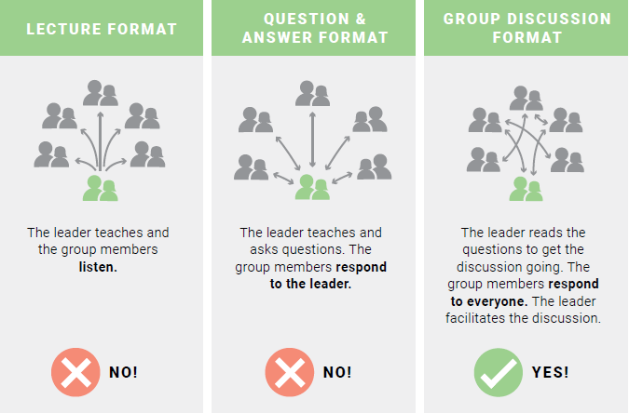
Leading a FamilyLife Group
Notes:
PRESENTER NOTES: Please emphasize both of these slides for inexperienced leaders.
SCRIPT:
“The best small group interaction happens Not in a Lecture Format nor a Q&A format. But, rather in a Group Discussion Format.
That way the leader reads the questions to get the discussion going. The group members respond to everyone. The leader simply facilitates the discussion.
Remind yourselves of this principle periodically during of your time together with the group!”

Slide 25
– Create an Inviting Atmosphere
Step 5
Provide a comfortable, relaxed setting.
Arrange the group so that everyone can have eye contact.
Greet each couple and introduce them to other group members.
Show respect for everyone by beginning and ending on time.
Encourage couples to complete their project. Praise those who do but don’t rebuke those who do not.
Optional: Serve simple snacks and beverages.
Notes:
PRESENTER NOTES: Point out that showing hospitality is a very biblical and godly quality.
SCRIPT:
“Create an Inviting Atmosphere
Provide a comfortable, relaxed setting.
Arrange the group so that everyone can have eye contact.
Greet each couple and introduce them to other group members.
Show respect for everyone by beginning and ending on time.
Encourage couples to complete their project. Praise those who do but don’t rebuke those who do not.
Optional: Serve SIMPLE snacks and beverages. It allows the group members to think “We could do this.” Usually serving snacks is better at the end. Otherwise, it will use up the discussion time. If you choose to begin with snacks, BE CERTAIN you have an agreed upon START to the group’s discussion time.”

Slide 26
Leading a Virtual Group
Begin with virtual etiquette.
Mute all mics unless speaking
Raise your hands to indicate a desire to share
Clap in a circle motion to show agreement
Using thumbs up/down to respond to Y/N questions presented to the group
Use the chat feature, if desired
Following other directions specific to the study
-Trevor and Tanya Kravick
Notes:
PRESENTER NOTES: Assure new leaders that there will be a return to normalcy.
SCRIPT:
“You CAN lead a small group study, even during this uncertain time of lockdown. Rest assured there WILL be a return to normalcy”. Until then, try leading the group with any one of the free virtual environments available like Google Meet, ZOOM or even Skype or FaceTime could work.
“Be sure to share the basics on virtual etiquette with everyone should you choose to host a small group remotely. Not everyone is familiar with this style of interaction. This includes:
Mute all mics off unless speaking. (This can be done as people log on.)
Group members can raise their hands to indicate a desire to share (either visually or using the software)
Clapping in a circular motion to show agreement (a “round of applause”) since the mics are muted. (There are also some icons in most virtual group software as well that can be clicked on to briefly show a “clap” on the participant’s screen.
Using thumbs up/down to respond to Y/N questions presented to the group
Using the chat feature if desired
Following other directions specific to the study”

Slide 27
Q & A
Notes:
SCRIPT: “We covered a lot of the basics to help you fell comfortable hosting and facilitating a small group. We’re going to take some time to see if you have any questions.”

Slide 28
Hidden slide for PRESENTER overview notes on animation and handouts
HIDDEN SLIDE
Notes:
PRESENTER NOTES:
TIP #1: Manually advancing animations with a click are a cosmetic enhancement allowing the presenter to focus on a point before moving to the next point. They are entirely up to the PRESENTER’s personal preference and are not necessary.
In fact, if there is too much animation using multiple styles it is VERY distracting and can take away from the presentation. However, once the presentation is given often enough and the presenter can time their delivery to coincide with the content the animated text / pictures can be VERY effective.
There is a duplicate of this presentation with animations embedded as an example in the FamilyLife Training library.
*************************************
TIP #2: You can print out this presentation as a handout in several formats. If you are offering the slides as a touchpoint for interactivity and note taking you may want to choose the 3 slide per page format. As a caution it is recommended to also print out a NOTES page in case something happens and you are unable to use the slide deck itself.

